Slide 1

( Programming Language 2 )
Course Introduction & Plan
Dr. Mohammed El-Said
Assistant Professor, Computer Science Dept.,
Faculty of Computers & Artificial Intelligence,
Helwan University - Cairo, Egypt.

Slide 2
Outline
Course Staff: Instructors (Short Bio)
Textbook
Course Contents
Agenda
Grades Distribution
Course Materials & Announcements
Outline
2

Slide 3
Course Staff: Instructors (Short Bio)
Dr. Mohammed El-Said
Bachelor in Computer Science from Helwan University
Masters in Computer Science (Image Processing) from Helwan University
PhD. in Computer Science (Computational Linguistics) from Helwan University

Slide 4

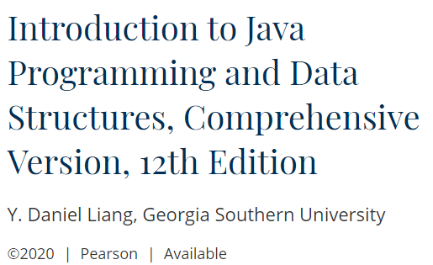
Textbook

Slide 5
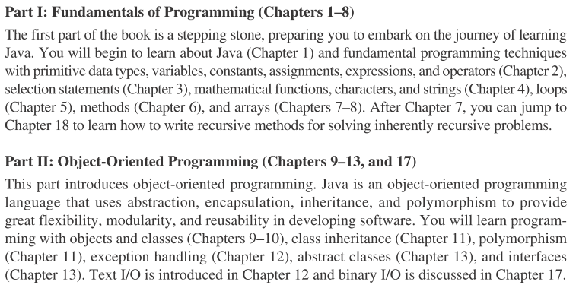
Course Contents

Slide 6
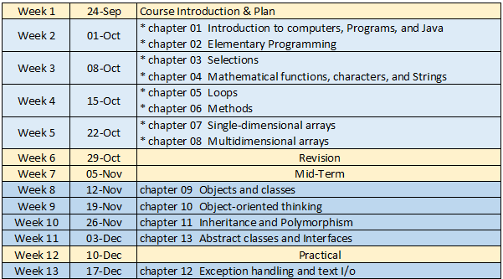
Agenda

Slide 7
Grades Distribution
Grades Distribution:
Final Written Exam 50%
Midterm Written Exam 20%
Sheets 10%
Quizzes 10%
Project 10%

Slide 8

Course Materials & Announcements
Course Webpage
fcai.smartpharaohs.com/pl2/2025
Announcements, and any supplemental notes will be made available “posted” online on the MS Teams Group
fe2hib1

Slide 9
Thanks! .. Questions?

