Slide 1
Chapter 16: Security

Slide 2
Chapter 16: Security
The Security Problem
Program Threats
System and Network Threats
Cryptography as a Security Tool
User Authentication
Implementing Security Defenses
Firewalling to Protect Systems and Networks
Computer-Security Classifications
An Example: Windows 7

Slide 3
Objectives
Discuss security threats and attacks
Explain the fundamentals of encryption, authentication, and hashing
Examine the uses of cryptography in computing
Describe the various countermeasures to security attacks

Slide 4
The Security Problem
System secure if resources used and accessed as intended under all circumstances
Unachievable
Intruders (crackers) attempt to breach security
Threat is potential security violation
Attack is attempt to breach security
Attack can be accidental or malicious
Easier to protect against accidental than malicious misuse

Slide 5
Security Violation Categories
Breach of confidentiality
Unauthorized reading of data
Breach of integrity
Unauthorized modification of data
Breach of availability
Unauthorized destruction of data
Theft of service
Unauthorized use of resources
Denial of service (DOS)
Prevention of legitimate use
Notes:
Integrity = سلامة البيانات

Slide 6
Security Violation Methods
Masquerading (breach authentication)
Pretending to be an authorized user to escalate privileges
Replay attack
As is or with message modification
Man-in-the-middle attack
Intruder sits in data flow, masquerading as sender to receiver and vice versa
Session hijacking
Intercept an already-established session to bypass authentication
Privilege escalation
Common attack type with access beyond what a user or resource is supposed to have

Slide 7
Security Measure Levels
Impossible to have absolute security, but make cost to perpetrator sufficiently high to deter most intruders
Security must occur at four levels to be effective:
Physical
Data centers, servers, connected terminals
Application
Benign or malicious apps can cause security problems
Operating System
Protection mechanisms, debugging
Network
Intercepted communications, interruption, DOS
Security is as weak as the weakest link in the chain
Humans a risk too via phishing and social-engineering attacks
Notes:
Perpetrator = مجرم, deter = ردع, benign = حميدة

Slide 8
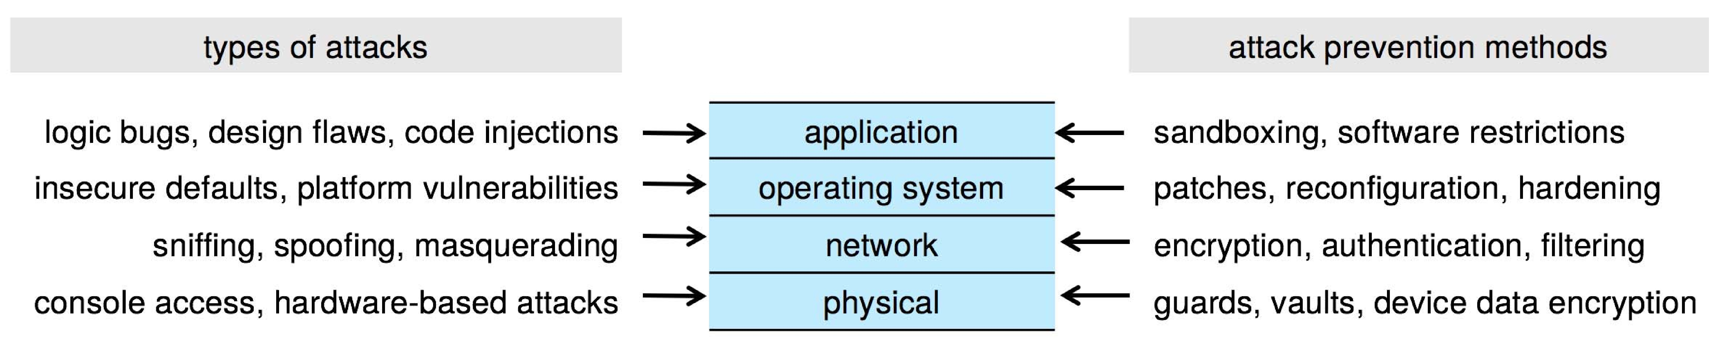
Four-layered Model of Security
Notes:
Sniffing = شم, spoofing = خداع

Slide 9
Program Threats
Many variations, many names
Trojan Horse
Code segment that misuses its environment
Exploits mechanisms for allowing programs written by users to be executed by other users
Spyware, pop-up browser windows, covert channels
Up to 80% of spam delivered by spyware-infected systems
Trap Door
Specific user identifier or password that circumvents normal security procedures
Could be included in a compiler
How to detect them?
Text editor, emulates a login program
banks, rounding errors
Notes:
Covert = خفي

Slide 10
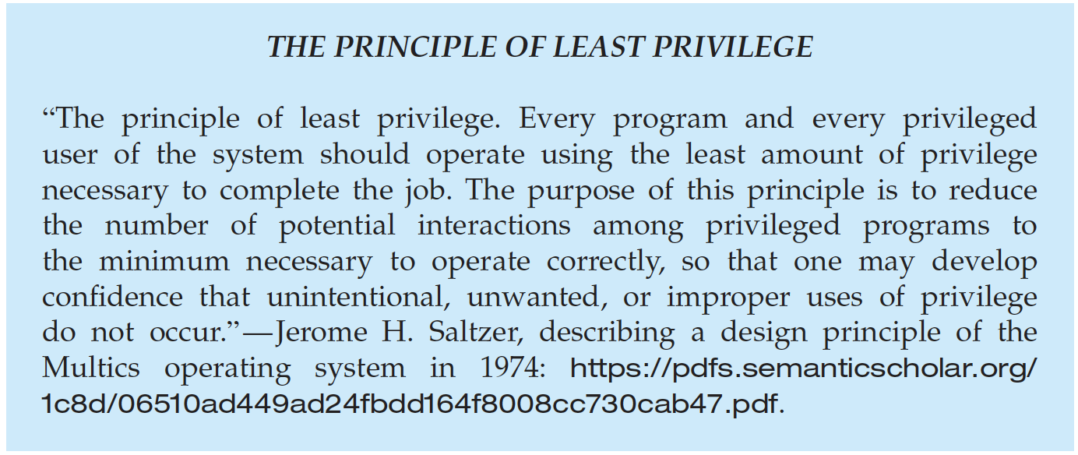
Program Threats (Cont.)
Malware - Software designed to exploit, disable, or damage computer
Trojan Horse – Program that acts in a clandestine manner س
Spyware – Program frequently installed with legitimate software to display ads, capture user data
Ransomware – locks up data via encryption, demanding payment to unlock it
Others include trap doors, logic bombs
All try to violate the Principle of Least Privilege
Goal frequently is to leave behind Remote Access Tool (RAT) for repeated access
Notes:
Clandestine = سري

Slide 11
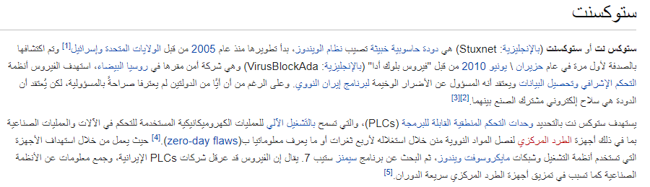
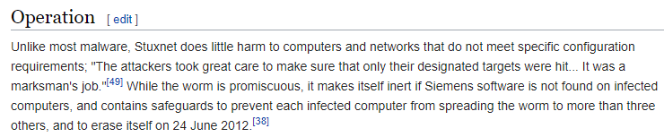
Logic Bomb Sample
https://ar.wikipedia.org/wiki/ستوكسنت
https://en.wikipedia.org/wiki/Stuxnet

Slide 12
Code Injection
Code-injection attack occurs when system code is not malicious but has bugs allowing executable code to be added or modified
Results from poor or insecure programming paradigms, commonly in low level languages like C or C++ which allow for direct memory access through pointers
Goal is a buffer overflow in which code is placed in a buffer and execution caused by the attack
Can be run by script kiddies – use tools written but exploit identifiers

Slide 13
C Program with Buffer-overflow Condition
#include <stdio.h>
#define BUFFER SIZE 256
int main(int argc, char *argv[])
{
char buffer[BUFFER SIZE];
if (argc < 2)
return -1;
else {
strcpy(buffer,argv[1]);
return 0;
}
}
Code review can help – programmers review each other’s code, looking for logic flows, programming flaws

Slide 14
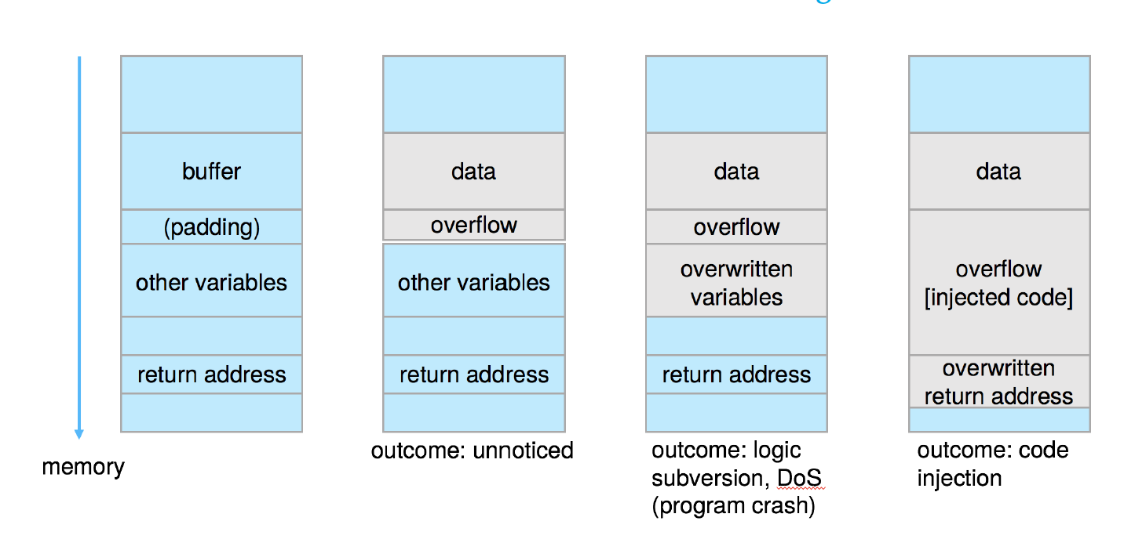
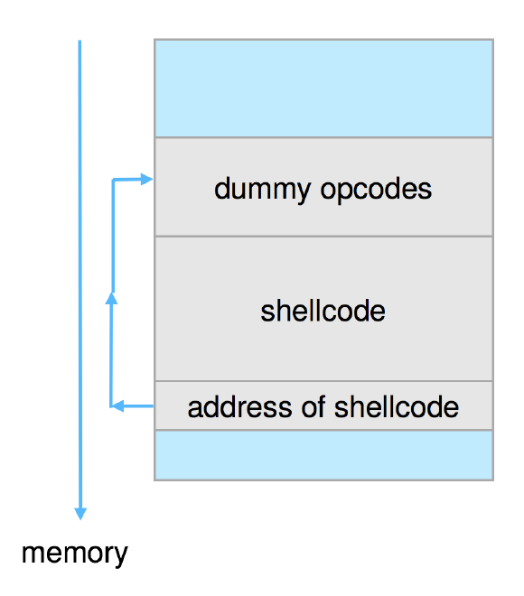
Code Injection (cont.)
Outcomes from code injection include:
Frequently use trampoline to code execution to exploit buffer overflow:

Slide 15
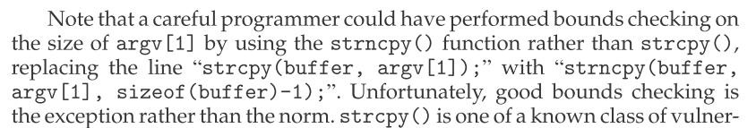
Great Programming Required?
For the first step of determining the bug, and second step of writing exploit code, yes
Script kiddies can run pre-written exploit code to attack a given system
Attack code can get a shell with the processes’ owner’s permissions
Or open a network port, delete files, download a program, etc
Depending on bug, attack can be executed across a network using allowed connections, bypassing firewalls
Buffer overflow can be disabled by disabling stack execution or adding bit to page table to indicate “non-executable” state
Available in SPARC and x86
But still have security exploits

Slide 16
Program Threats (Cont.)
Viruses
Code fragment embedded in legitimate program
Self-replicating, designed to infect other computers
Very specific to CPU architecture, operating system, applications
Usually borne via email or as a macro
Visual Basic Macro to reformat hard drive
Sub AutoOpen()
Dim oFS
Set oFS = CreateObject(’’Scripting.FileSystemObject’’)
vs = Shell(’’c:command.com /k format c:’’,vbHide)
End Sub

Slide 17
Program Threats (Cont.)
Virus dropper inserts virus onto the system
Many categories of viruses, literally many thousands of viruses
File / parasitic
Boot / memory
Macro
Source code
Polymorphic to avoid having a virus signature
Encrypted
Stealth
Tunneling
Multipartite
Armored

Slide 18
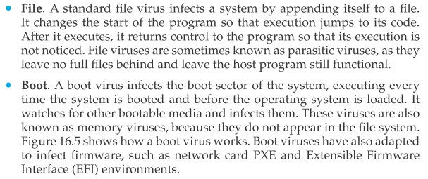
Program Threats (Cont.)
Notes:
Parasitic = طفيلية

Slide 19
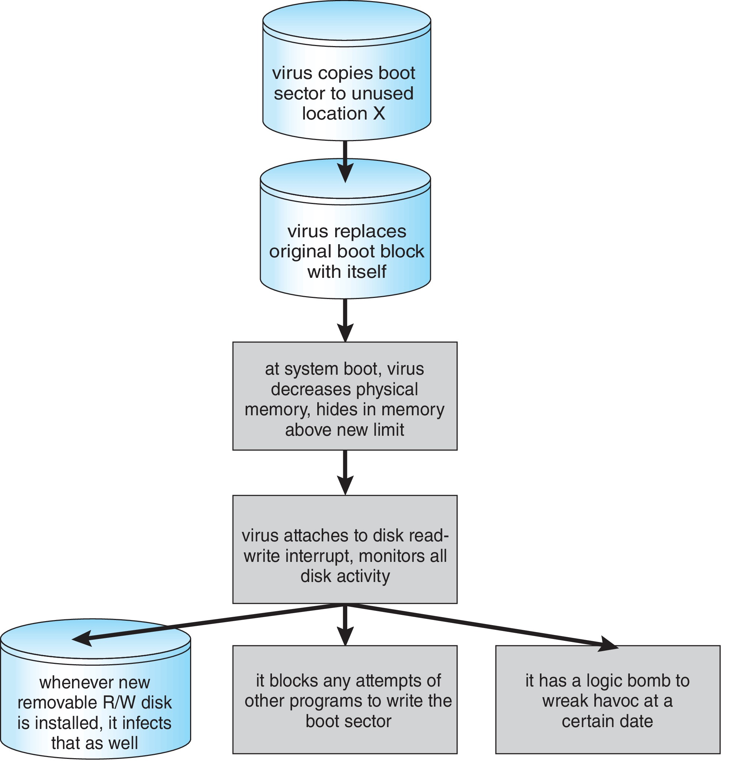
A Boot-sector Computer Virus

Slide 20
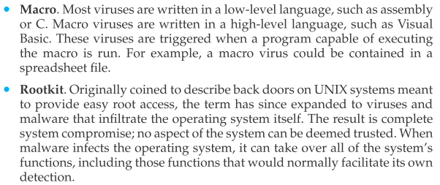
Program Threats (Cont.)

Slide 21
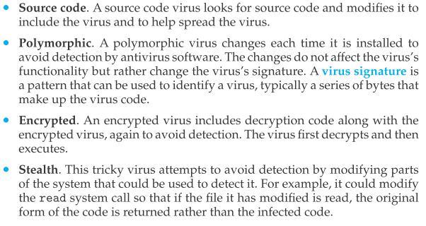
Program Threats (Cont.)

Slide 22
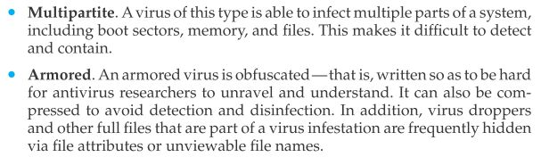
Program Threats (Cont.)

Slide 23
The Threat Continues
Attacks still common, still occurring
Attacks moved over time from science experiments to tools of organized crime
Targeting specific companies
Creating botnets to use as tool for spam and DDOS delivery
Keystroke logger to grab passwords, credit card numbers
Why is Windows the target for most attacks?
Most common
Everyone is an administrator
Licensing required?
Monoculture considered harmful

Slide 24
System and Network Threats
Some systems “open” rather than secure by default
Reduce attack surface
But harder to use, more knowledge needed to administer
Network threats harder to detect, prevent
Protection systems weaker
More difficult to have a shared secret on which to base access
No physical limits once system attached to internet
Or on network with system attached to internet
Even determining location of connecting system difficult
IP address is only knowledge

Slide 25
System and Network Threats (Cont.)
Worms – use spawn mechanism; standalone program
Internet worm
Exploited UNIX networking features (remote access) and bugs in finger and sendmail programs
Exploited trust-relationship mechanism used by rsh to access friendly systems without use of password
Grappling hook program uploaded main worm program
99 lines of C code
Hooked system then uploaded main code, tried to attack connected systems
Also tried to break into other users accounts on local system via password guessing
If target system already infected, abort, except for every 7th time

Slide 26
System and Network Threats (Cont.)
Port scanning
Automated attempt to connect to a range of ports on one or a range of IP addresses
Detection of answering service protocol
Detection of OS and version running on system
nmap scans all ports in a given IP range for a response
nessus has a database of protocols and bugs (and exploits) to apply against a system
Frequently launched from zombie systems
To decrease trace-ability

Slide 27
System and Network Threats (Cont.)
Denial of Service
Overload the targeted computer preventing it from doing any useful work
Distributed Denial-of-Service (DDoS) come from multiple sites at once
Consider the start of the IP-connection handshake (SYN)
How many started-connections can the OS handle?
Consider traffic to a web site
How can you tell the difference between being a target and being really popular?
Accidental – CS students writing bad fork() code
Purposeful – extortion, punishment
Port scanning
Automated tool to look for network ports accepting connections
Used for good and evil

Slide 28
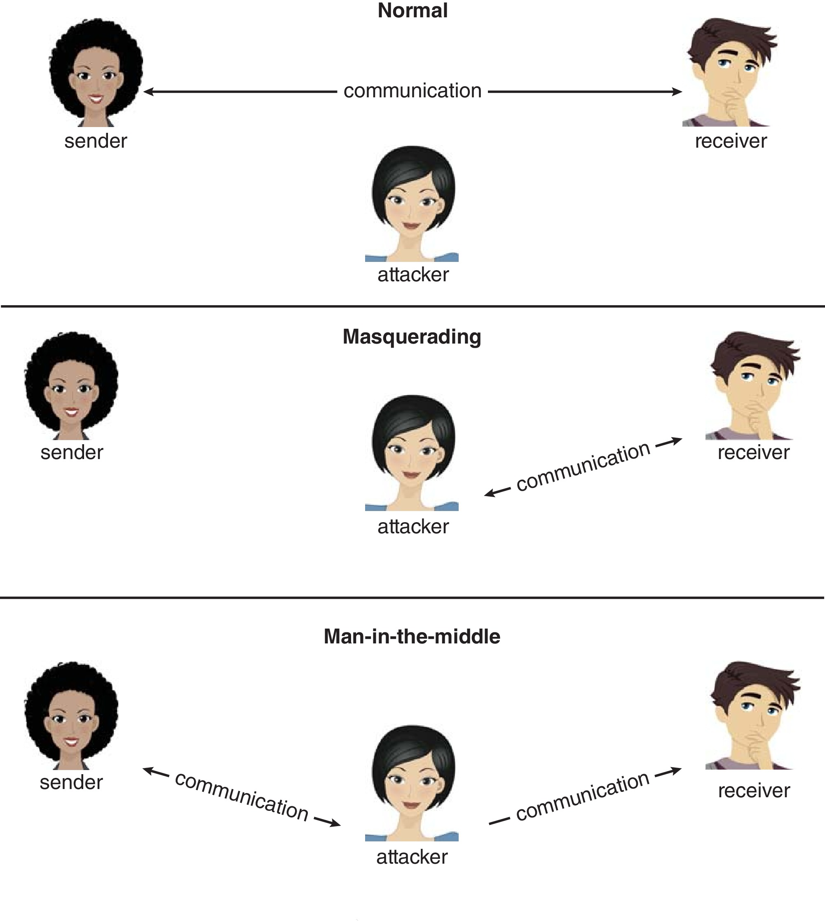
Standard Security Attacks

Slide 29
Cryptography as a Security Tool
Broadest security tool available
Internal to a given computer, source and destination of messages can be known and protected
OS creates, manages, protects process IDs, communication ports
Source and destination of messages on network cannot be trusted without cryptography
Local network – IP address?
Consider unauthorized host added
WAN / Internet – how to establish authenticity
Not via IP address

Slide 30
Cryptography
Means to constrain potential senders (sources) and / or receivers (destinations) of messages
Based on secrets (keys)
Enables
Confirmation of source
Receipt only by certain destination
Trust relationship between sender and receiver

Slide 31
Encryption
Constrains the set of possible receivers of a message
Encryption algorithm consists of
Set K of keys
Set M of Messages
Set C of ciphertexts (encrypted messages)
A function E : K → (M→C). That is, for each k ∈ K, E_{k} is a function for generating ciphertexts from messages
Both E and E_{k} for any k should be efficiently computable functions
A function D : K → (C → M). That is, for each k ∈ K, D_{k} is a function for generating messages from ciphertexts
Both D and D_{k} for any k should be efficiently computable functions

Slide 32
Encryption (Cont.)
An encryption algorithm must provide this essential property: Given a ciphertext c ∈ C, a computer can compute m such that E_{k}(m) = c only if it possesses k
Thus, a computer holding k can decrypt ciphertexts to the plaintexts used to produce them, but a computer not holding k cannot decrypt ciphertexts
Since ciphertexts are generally exposed (for example, sent on the network), it is important that it be infeasible to derive k from the ciphertexts

Slide 33
Symmetric Encryption
Same key used to encrypt and decrypt
Therefore k must be kept secret
DES was most commonly used symmetric block-encryption algorithm (created by US Govt)
Encrypts a block of data at a time
Keys too short so now considered insecure
Triple-DES considered more secure
Algorithm used 3 times using 2 or 3 keys
For example
2001 NIST adopted new block cipher - Advanced Encryption Standard (AES)
Keys of 128, 192, or 256 bits, works on 128 bit blocks
RC4 is most common symmetric stream cipher, but known to have vulnerabilities
Encrypts/decrypts a stream of bytes (i.e., wireless transmission)
Key is a input to pseudo-random-bit generator
Generates an infinite keystream

Slide 34
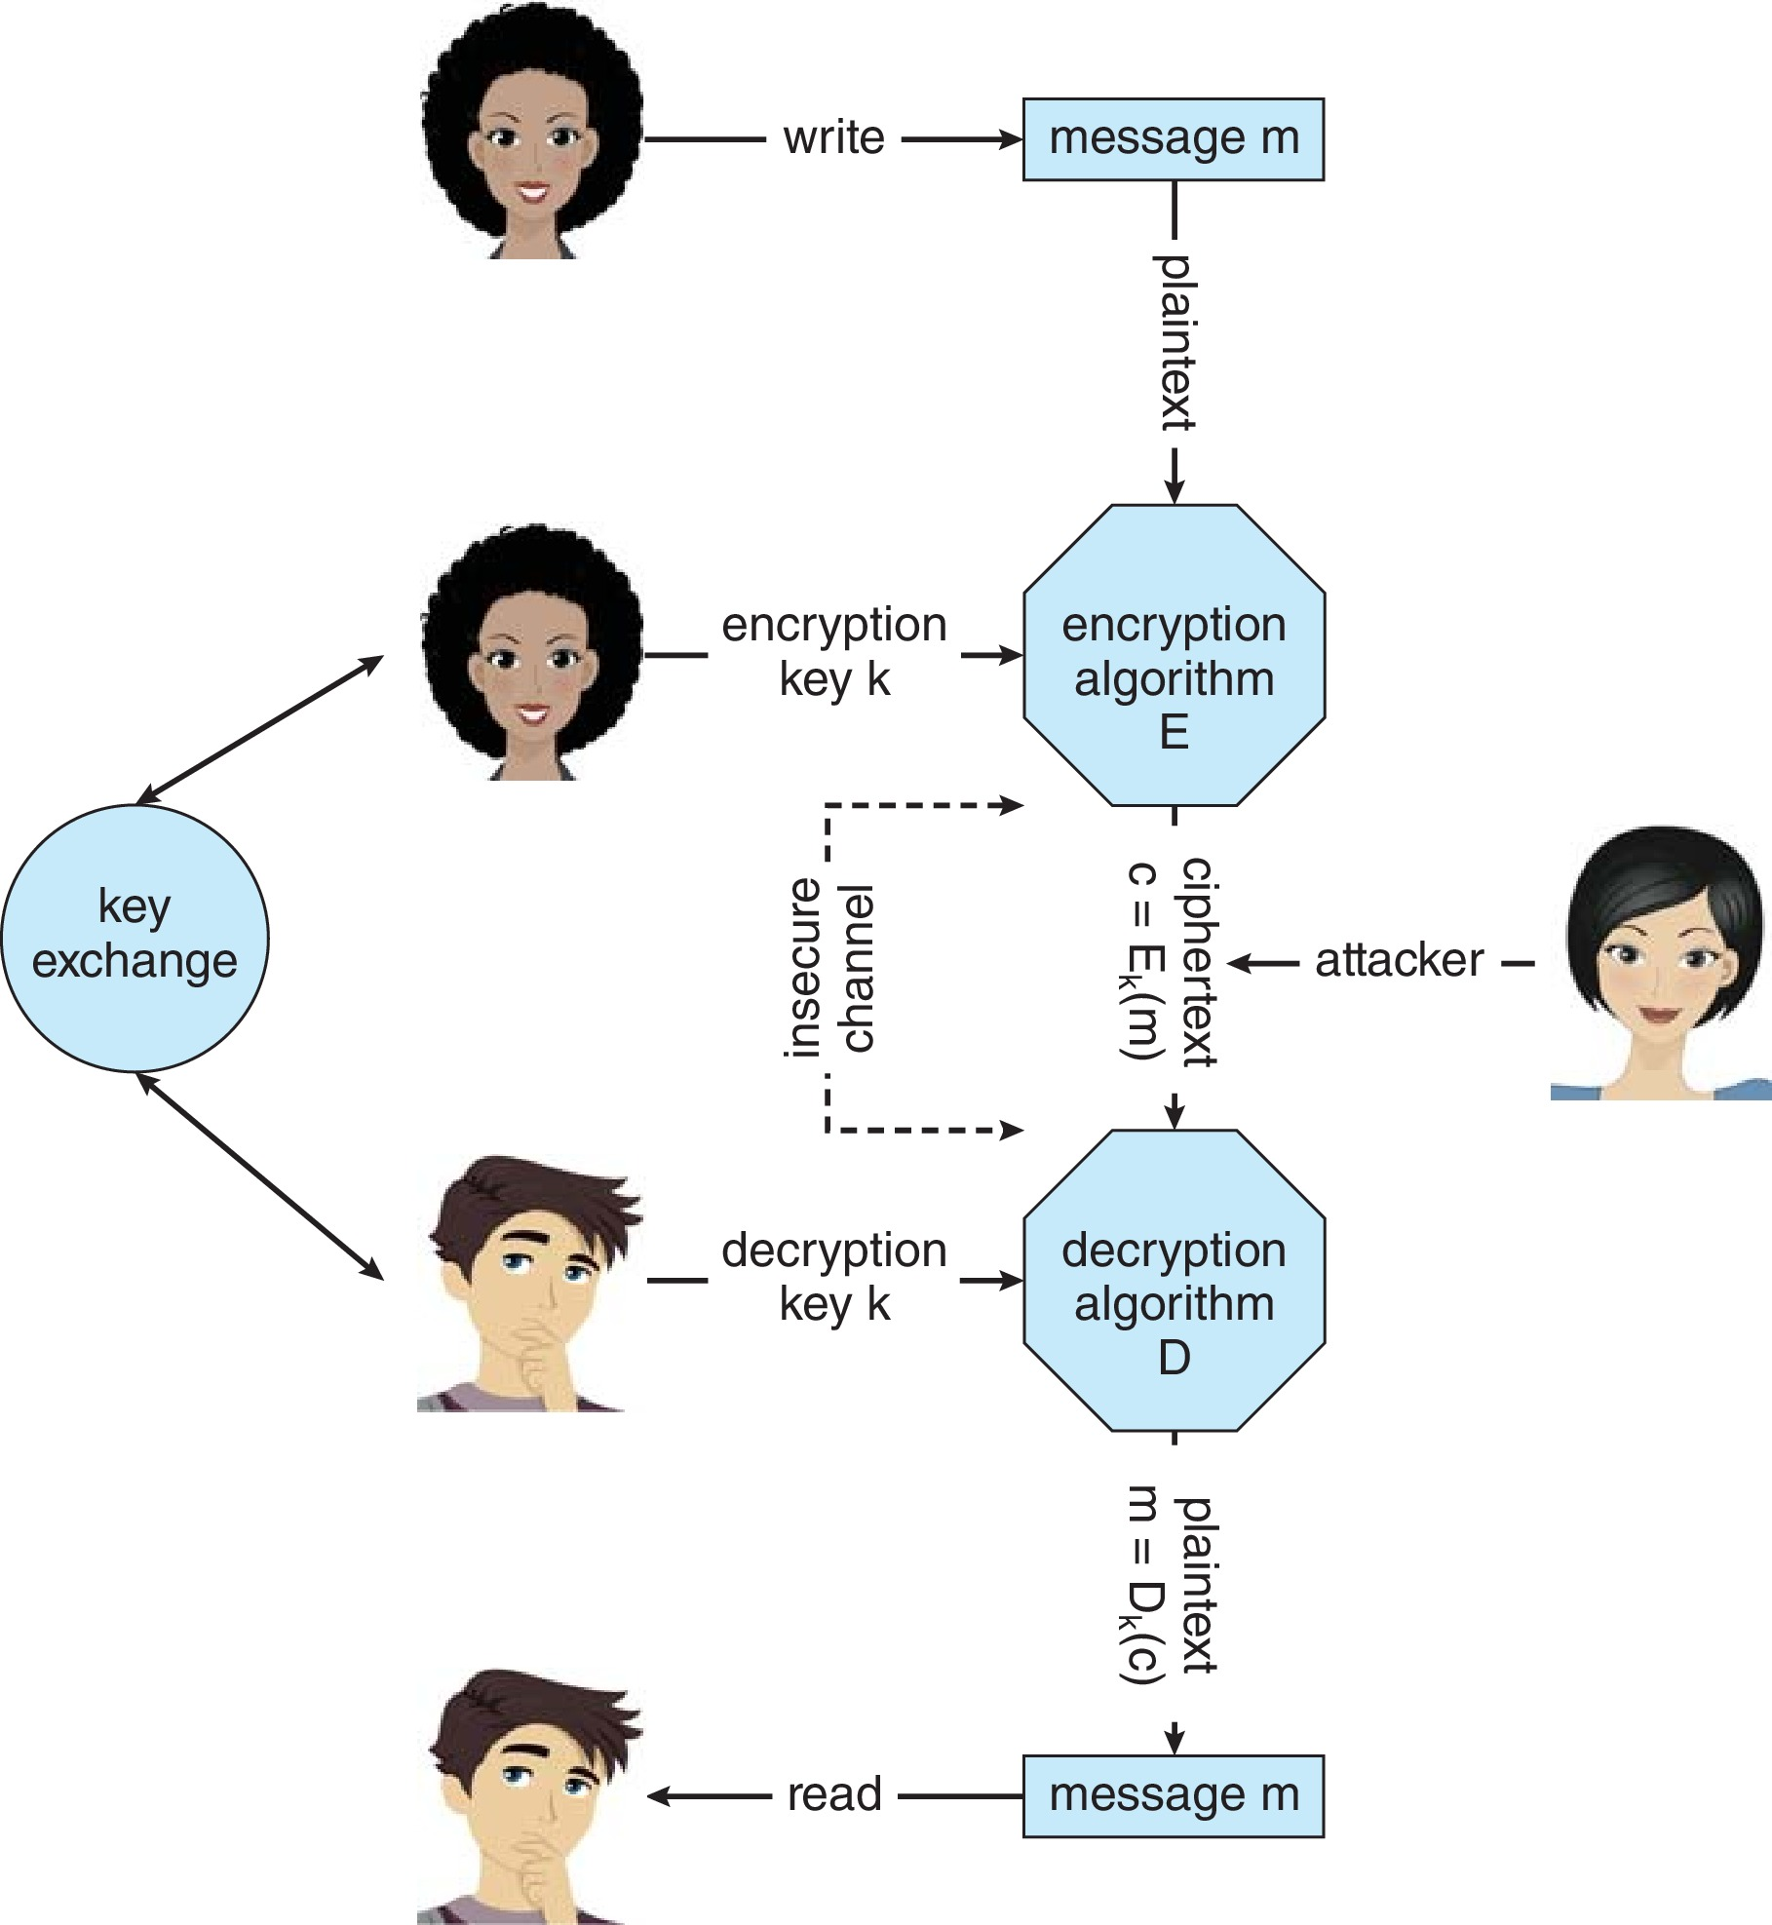
Secure Communication over Insecure Medium

Slide 35
Asymmetric Encryption
Public-key encryption based on each user having two keys:
public key – published key used to encrypt data
private key – key known only to individual user used to decrypt data
Must be an encryption scheme that can be made public without making it easy to figure out the decryption scheme
Most common is RSA block cipher
Efficient algorithm for testing whether or not a number is prime
No efficient algorithm is know for finding the prime factors of a number

Slide 36
Asymmetric Encryption (Cont.)
Formally, it is computationally infeasible to derive k_{d,N} from k_{e,N}, and so k_{e} need not be kept secret and can be widely disseminated
k_{e} is the public key
k_{d} is the private key
N is the product of two large, randomly chosen prime numbers p and q (for example, p and q are 512 bits each)
Encryption algorithm is E_{ke,N}(m) = m^{ke} mod N, where k_{e} satisfies k_{e}k_{d} mod (p−1)(q −1) = 1
The decryption algorithm is then D_{kd,N}(c) = c^{kd} mod N

Slide 37
Asymmetric Encryption Example
For example. make p = 7and q = 13
We then calculate N = 7∗13 = 91 and (p−1)(q−1) = 72
We next select k_{e} relatively prime to 72 and< 72, yielding 5
Finally, we calculate k_{d} such that k_{e}k_{d} mod 72 = 1, yielding 29
We how have our keys
Public key, k_{e,N} = 5, 91
Private key, k_{d,N} = 29, 91
Encrypting the message 69 with the public key results in the cyphertext 62
Cyphertext can be decoded with the private key
Public key can be distributed in cleartext to anyone who wants to communicate with holder of public key

Slide 38
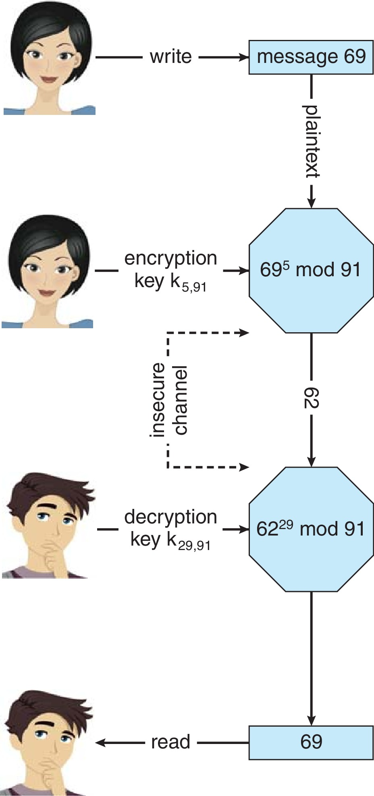
Encryption using RSA Asymmetric Cryptography

Slide 39
Cryptography (Cont.)
Note symmetric cryptography based on transformations, asymmetric based on mathematical functions
Asymmetric much more compute intensive
Typically not used for bulk data encryption

Slide 40
Authentication
Constraining set of potential senders of a message
Complementary to encryption
Also can prove message unmodified
Algorithm components
A set K of keys
A set M of messages
A set A of authenticators
A function S : K → (M→ A)
That is, for each k ∈ K, S_{k} is a function for generating authenticators from messages
Both S and S_{k} for any k should be efficiently computable functions
A function V : K → (M × A→ {true, false}). That is, for each k ∈ K, V_{k} is a function for verifying authenticators on messages
Both V and V_{k} for any k should be efficiently computable functions

Slide 41
Authentication (Cont.)
For a message m, a computer can generate an authenticator a ∈ A such that V_{k}(m, a) = true only if it possesses k
Thus, computer holding k can generate authenticators on messages so that any other computer possessing k can verify them
Computer not holding k cannot generate authenticators on messages that can be verified using V_{k}
Since authenticators are generally exposed (for example, they are sent on the network with the messages themselves), it must not be feasible to derive k from the authenticators
Practically, if V_{k}(m,a) = true then we know m has not been modified and that send of message has k
If we share k with only one entity, know where the message originated

Slide 42
Authentication – Hash Functions
Basis of authentication
Creates small, fixed-size block of data message digest (hash value) from m
Hash Function H must be collision resistant on m
Must be infeasible to find an m’ ≠ m such that H(m) = H(m’)
If H(m) = H(m’), then m = m’
The message has not been modified
Common message-digest functions include MD5, which produces a 128-bit hash, and SHA-1, which outputs a 160-bit hash
Not useful as authenticators
For example H(m) can be sent with a message
But if H is known someone could modify m to m’ and recompute H(m’) and modification not detected
So must authenticate H(m)

Slide 43
Authentication - MAC
Symmetric encryption used in message-authentication code (MAC) authentication algorithm
Cryptographic checksum generated from message using secret key
Can securely authenticate short values
If used to authenticate H(m) for an H that is collision resistant, then obtain a way to securely authenticate long message by hashing them first
Note that k is needed to compute both S_{k} and V_{k}, so anyone able to compute one can compute the other

Slide 44
Authentication – Digital Signature
Based on asymmetric keys and digital signature algorithm
Authenticators produced are digital signatures
Very useful – anyone can verify authenticity of a message
In a digital-signature algorithm, computationally infeasible to derive k_{s} from k_{v}
V is a one-way function
Thus, k_{v} is the public key and k_{s} is the private key
Consider the RSA digital-signature algorithm
Similar to the RSA encryption algorithm, but the key use is reversed
Digital signature of message S_{ks} (m) = H(m)^{ks} mod N
The key k_{s} again is a pair (d, N), where N is the product of two large, randomly chosen prime numbers p and q
Verification algorithm is V_{kv}(m, a) (a^{kv} mod N = H(m))
Where k_{v} satisfies k_{v}k_{s} mod (p − 1)(q − 1) = 1

Slide 45
Authentication (Cont.)
Why authentication if a subset of encryption?
Fewer computations (except for RSA digital signatures)
Authenticator usually shorter than message
Sometimes want authentication but not confidentiality
Signed patches et al
Can be basis for non-repudiation

Slide 46
Key Distribution
Delivery of symmetric key is huge challenge
Sometimes done out-of-band
Asymmetric keys can proliferate – stored on key ring
Even asymmetric key distribution needs care – man-in-the-middle attack

Slide 47
Digital Certificates
Proof of who or what owns a public key
Public key digitally signed a trusted party
Trusted party receives proof of identification from entity and certifies that public key belongs to entity
Certificate authority are trusted party – their public keys included with web browser distributions
They vouch for other authorities via digitally signing their keys, and so on

Slide 48
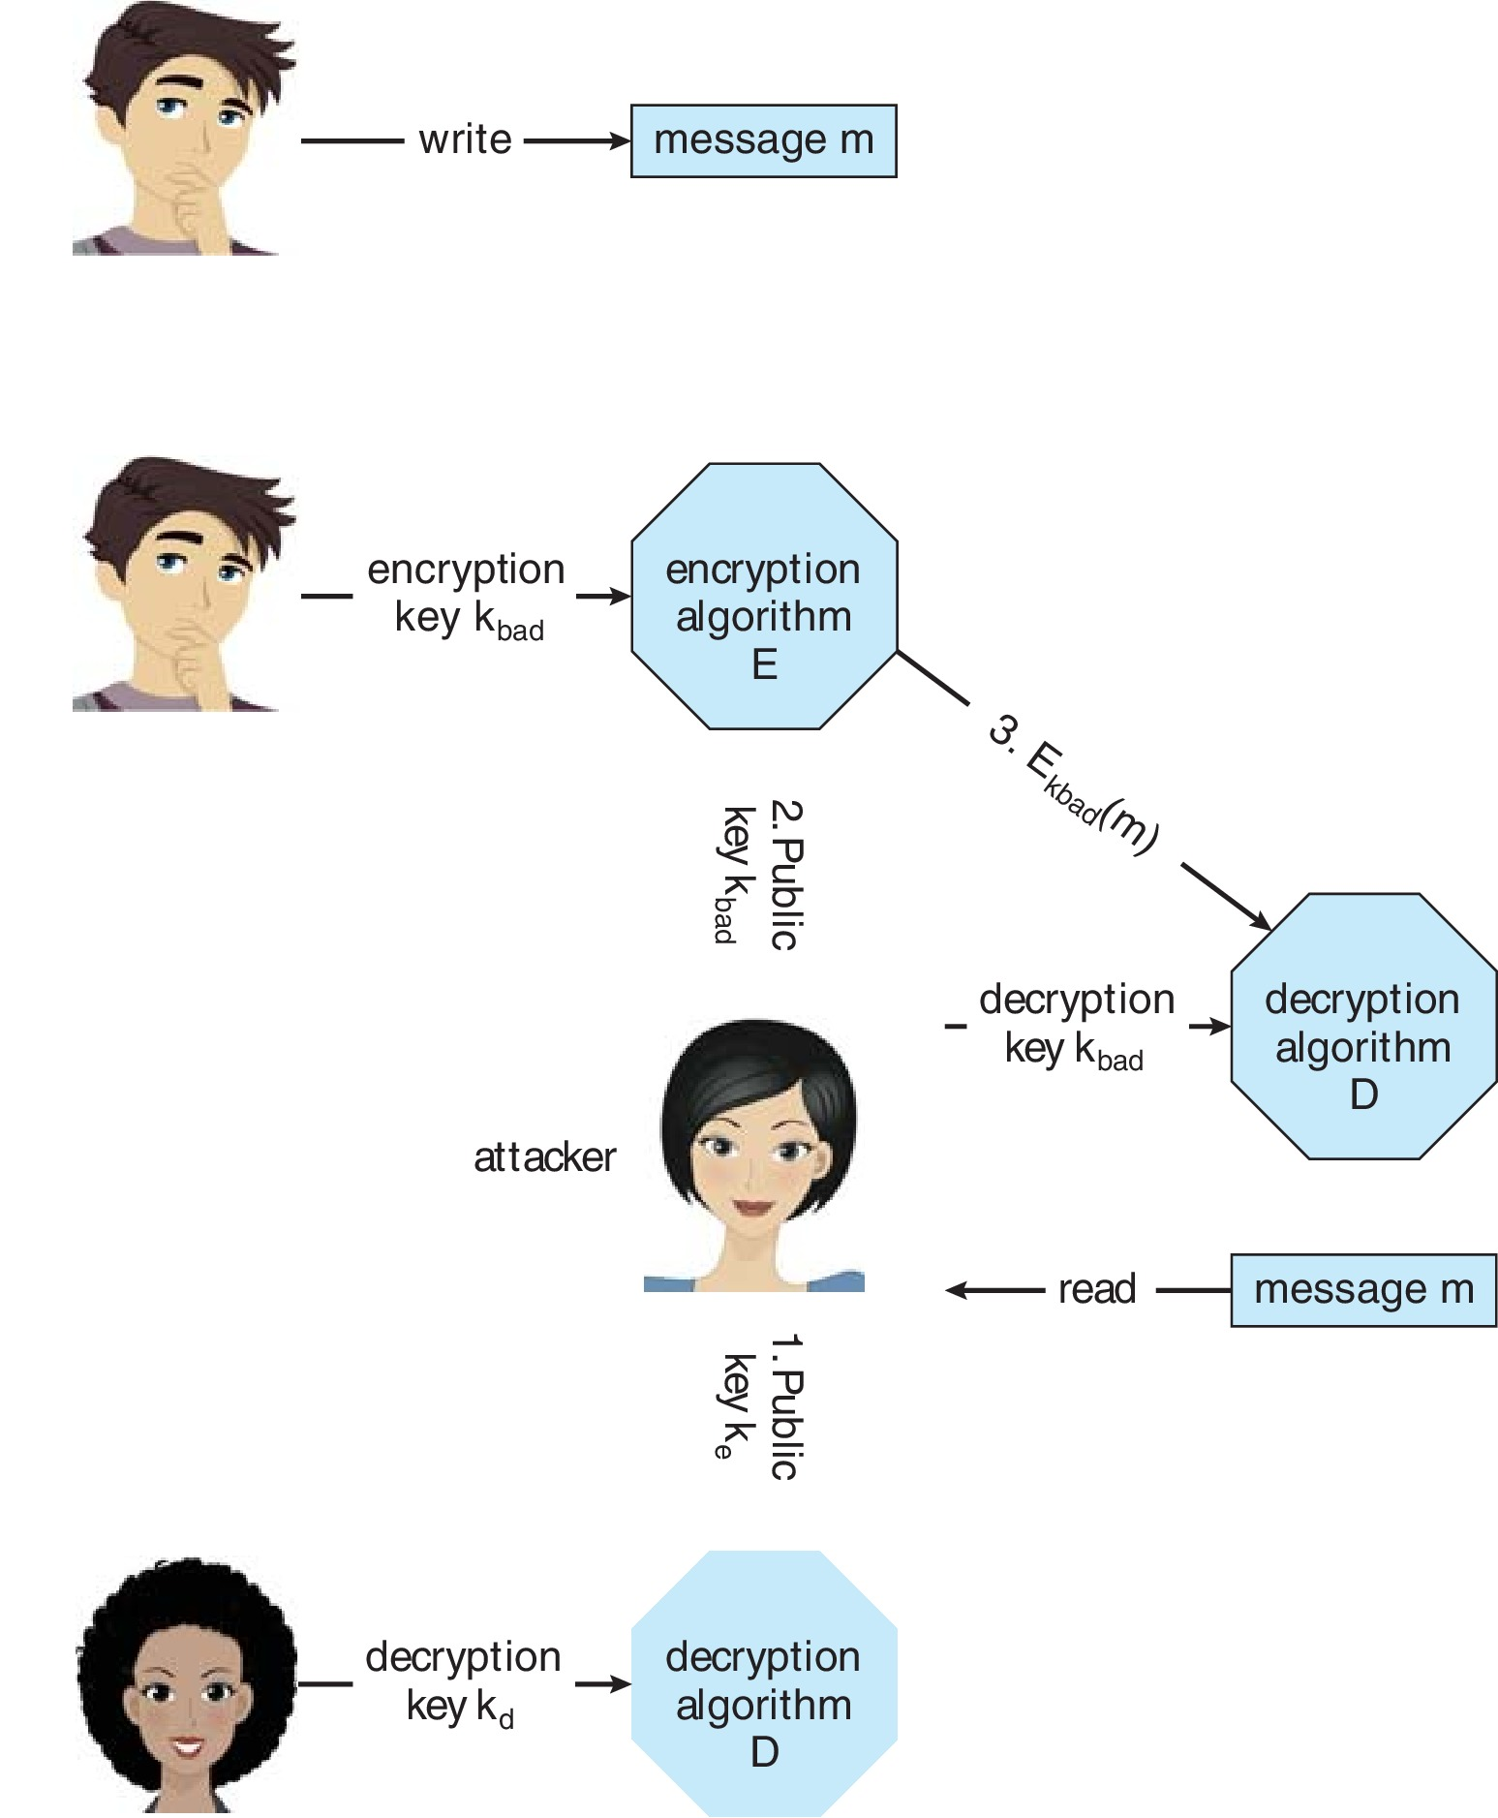
Man-in-the-middle Attack on Asymmetric Cryptography

Slide 49
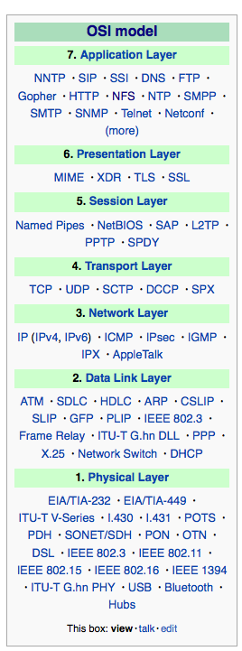
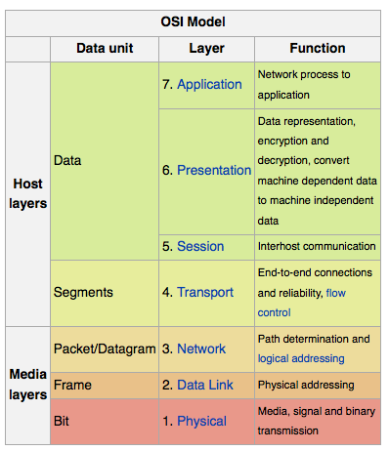
Implementation of Cryptography
Can be done at various layers of ISO Reference Model
SSL at the Transport layer
Network layer is typically IPSec
IKE for key exchange
Basis of Virtual Private Networks (VPNs)
Why not just at lowest level?
Sometimes need more knowledge than available at low levels
i.e. User authentication
i.e. e-mail delivery
Source: http://en.wikipedia.org/wiki/OSI_model

Slide 50
Encryption Example - TLS
Insertion of cryptography at one layer of the ISO network model (the transport layer)
SSL – Secure Socket Layer (also called TLS)
Cryptographic protocol that limits two computers to only exchange messages with each other
Very complicated, with many variations
Used between web servers and browsers for secure communication (credit card numbers)
The server is verified with a certificate assuring client is talking to correct server
Asymmetric cryptography used to establish a secure session key (symmetric encryption) for bulk of communication during session
Communication between each computer then uses symmetric key cryptography
More details in textbook

Slide 51
User Authentication
Crucial to identify user correctly, as protection systems depend on user ID
User identity most often established through passwords, can be considered a special case of either keys or capabilities
Passwords must be kept secret
Frequent change of passwords
History to avoid repeats
Use of “non-guessable” passwords
Log all invalid access attempts (but not the passwords themselves)
Unauthorized transfer
Passwords may also either be encrypted or allowed to be used only once
Does encrypting passwords solve the exposure problem?
Might solve sniffing
Consider shoulder surfing
Consider Trojan horse keystroke logger
How are passwords stored at authenticating site?

Slide 52
Passwords
Encrypt to avoid having to keep secret
But keep secret anyway (i.e. Unix uses superuser-only readably file /etc/shadow)
Use algorithm easy to compute but difficult to invert
Only encrypted password stored, never decrypted
Add “salt” to avoid the same password being encrypted to the same value
One-time passwords
Use a function based on a seed to compute a password, both user and computer
Hardware device / calculator / key fob to generate the password
Changes very frequently
Biometrics
Some physical attribute (fingerprint, hand scan)
Multi-factor authentication
Need two or more factors for authentication
i.e. USB “dongle”, biometric measure, and password

Slide 53
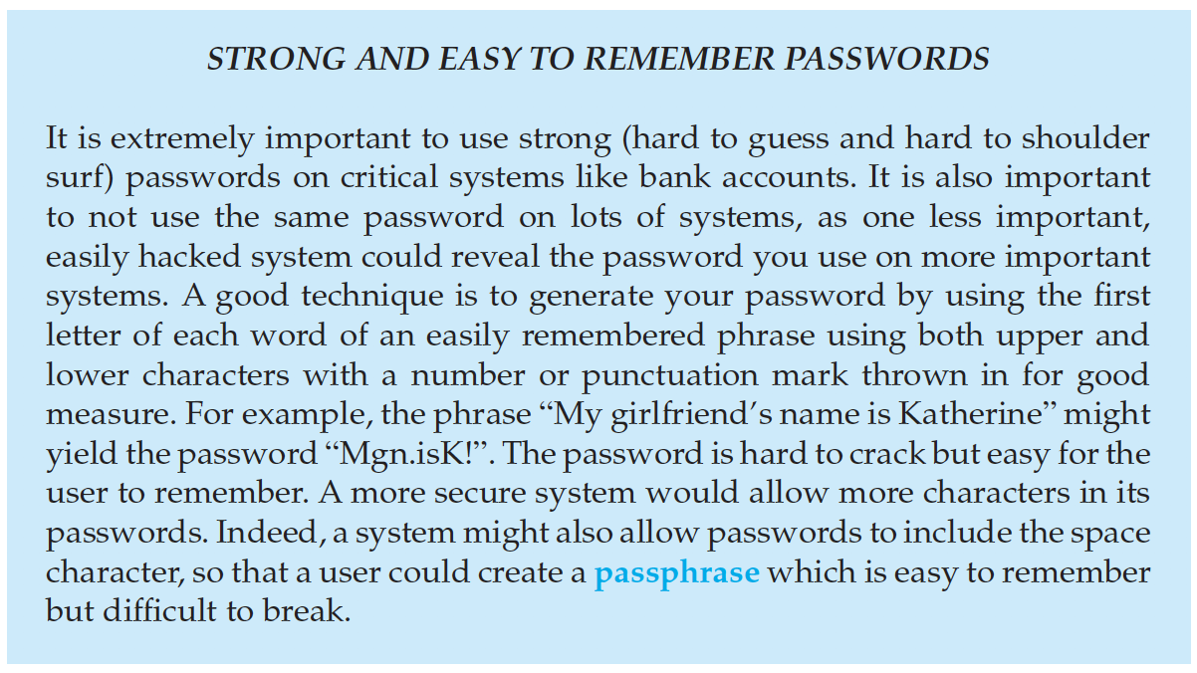
Passwords (cont.)

Slide 54
Implementing Security Defenses
Defense in depth is most common security theory – multiple layers of security
Security policy describes what is being secured
Vulnerability assessment compares real state of system / network compared to security policy
Intrusion detection endeavors to detect attempted or successful intrusions
Signature-based detection spots known bad patterns
Anomaly detection spots differences from normal behavior
Can detect zero-day attacks
False-positives and false-negatives a problem
Virus protection
Searching all programs or programs at execution for known virus patterns
Or run in sandbox so can’t damage system
Auditing, accounting, and logging of all or specific system or network activities
Practice safe computing – avoid sources of infection, download from only “good” sites, etc

Slide 55
Firewalling to Protect Systems and Networks
A network firewall is placed between trusted and untrusted hosts
The firewall limits network access between these two security domains
Can be tunneled or spoofed
Tunneling allows disallowed protocol to travel within allowed protocol (i.e., telnet inside of HTTP)
Firewall rules typically based on host name or IP address which can be spoofed
Personal firewall is software layer on given host
Can monitor / limit traffic to and from the host
Application proxy firewall understands application protocol and can control them (i.e., SMTP)
System-call firewall monitors all important system calls and apply rules to them (i.e., this program can execute that system call)

Slide 56
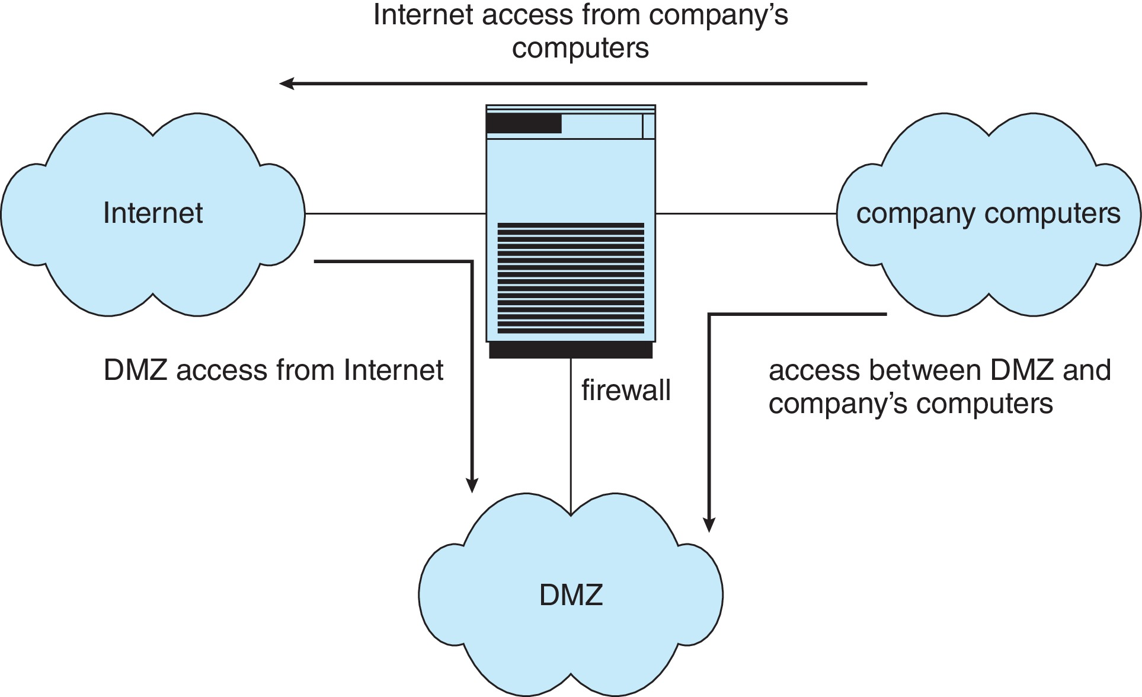
Network Security Through Domain Separation Via Firewall

Slide 57
Computer Security Classifications
U.S. Department of Defense outlines four divisions of computer security: A, B, C, and D
D – Minimal security
C – Provides discretionary protection through auditing
Divided into C1 and C2
C1 identifies cooperating users with the same level of protection
C2 allows user-level access control
B – All the properties of C, however each object may have unique sensitivity labels
Divided into B1, B2, and B3
A – Uses formal design and verification techniques to ensure security

Slide 58
Security Defenses Summarized
By applying appropriate layers of defense, we can keep systems safe from all but the most persistent attackers. In summary, these layers may include the following:
Educate users about safe computing—don’t attach devices of unknown origin to the computer, don’t share passwords, use strong passwords, avoid falling for social engineering appeals, realize that an e-mail is not necessarily a private communication, and so on
Educate users about how to prevent phishing attacks—don’t click on email attachments or links from unknown (or even known) senders; authenticate (for example, via a phone call) that a request is legitimate
Use secure communication when possible
Physically protect computer hardware
Configure the operating system to minimize the attack surface; disable all unused services
Configure system daemons, privileges applications, and services to be as secure as possible

Slide 59
Security Defenses Summarized (cont.)
Use modern hardware and software, as they are likely to have up-to-date security features
Keep systems and applications up to date and patched
Only run applications from trusted sources (such as those that are code signed)
Enable logging and auditing; review the logs periodically, or automate alerts
Install and use antivirus software on systems susceptible to viruses, and keep the software up to date
Use strong passwords and passphrases, and don’t record them where they could be found
Use intrusion detection, firewalling, and other network-based protection systems as appropriate
For important facilities, use periodic vulnerability assessments and other testing methods to test security and response to incidents

Slide 60
Security Defenses Summarized (cont.)
Encrypt mass-storage devices, and consider encrypting important individual files as well
Have a security policy for important systems and facilities, and keep it up to date

Slide 61
End of Chapter 16

