Slide 1
Chapter 7: Synchronization Examples

Slide 2
Classical Problems of Synchronization
Classical problems used to test newly-proposed synchronization schemes
  Bounded-Buffer Problem
  Readers and Writers Problem
  Dining-Philosophers Problem

Slide 3
Bounded-Buffer Problem
n buffers, each can hold one item
Semaphore mutex initialized to the value 1
Semaphore full initialized to the value 0
Semaphore empty initialized to the value n

Slide 4
Bounded Buffer Problem (Cont.)
The structure of the producer process
while (true) {
...
/* produce an item in next_produced */
...
wait(empty);
wait(mutex);
...
/* add next produced to the buffer */
...
signal(mutex);
signal(full);
}

Slide 5
Bounded Buffer Problem (Cont.)
The structure of the consumer process
while (true) {
wait(full);
wait(mutex);
...
/* remove an item from buffer to next_consumed */
...
signal(mutex);
signal(empty);
...
/* consume the item in next consumed */
...
}

Slide 6
Readers-Writers Problem
A data set is shared among a number of concurrent processes
  Readers – only read the data set; they do not perform any updates
  Writers – can both read and write
Problem – allow multiple readers to read at the same time
  Only one single writer can access the shared data at the same time
Several variations of how readers and writers are considered – all involve some form of priorities
Shared Data
  Data set
  Semaphore rw_mutex initialized to 1
  Semaphore mutex initialized to 1
  Integer read_count initialized to 0

Slide 7
Readers-Writers Problem (Cont.)
The structure of a writer process
while (true) {
wait(rw_mutex);
...
/* writing is performed */
...
signal(rw_mutex);
}

Slide 8
Readers-Writers Problem (Cont.)
The structure of a reader process
while (true){
wait(mutex);
read_count++;
if (read_count == 1)
wait(rw_mutex);
signal(mutex);
...
/* reading is performed */
...
wait(mutex);
read count--;
if (read_count == 0)
signal(rw_mutex);
signal(mutex);
}

Slide 9
Readers-Writers Problem Variations
First variation – no reader kept waiting unless writer has permission to use shared object
Second variation – once writer is ready, it performs the write ASAP
Both may have starvation leading to even more variations
Problem is solved on some systems by kernel providing reader-writer locks

Slide 10

Dining-Philosophers Problem
Philosophers spend their lives alternating thinking and eating
Don’t interact with their neighbors, occasionally try to pick up 2 chopsticks (one at a time) to eat from bowl
  Need both to eat, then release both when done
In the case of 5 philosophers
  Shared data
    Bowl of rice (data set)
    Semaphore chopstick [5] initialized to 1

Slide 11
Dining-Philosophers Problem Algorithm
Semaphore Solution
The structure of Philosopher i:
    while (true){
    wait (chopstick[i] );
    wait (chopStick[ (i + 1) % 5] );
    /* eat for awhile */
    signal (chopstick[i] );
    signal (chopstick[ (i + 1) % 5] );
    /* think for awhile */
    }
What is the problem with this algorithm?

Slide 12
Monitor Solution to Dining Philosophers
monitor DiningPhilosophers
{
enum { THINKING, HUNGRY, EATING) state [5] ;
condition self [5];
void pickup (int i) {
state[i] = HUNGRY;
test(i);
if (state[i] != EATING)
self[i].wait;
}
void putdown (int i) {
state[i] = THINKING;
// test left and right neighbors
test((i + 4) % 5);
test((i + 1) % 5);
}

Slide 13
Solution to Dining Philosophers (Cont.)
void test (int i) {
if ((state[(i + 4) % 5] != EATING) &&
(state[i] == HUNGRY) &&
(state[(i + 1) % 5] != EATING) ) {
state[i] = EATING ;
self[i].signal () ;
}
}
initialization_code() {
for (int i = 0; i < 5; i++)
state[i] = THINKING;
}
}

Slide 14
Solution to Dining Philosophers (Cont.)
Each philosopher i invokes the operations pickup() and putdown() in the following sequence:
DiningPhilosophers.pickup(i);
/** EAT **/
DiningPhilosophers.putdown(i);
No deadlock, but starvation is possible

Slide 15
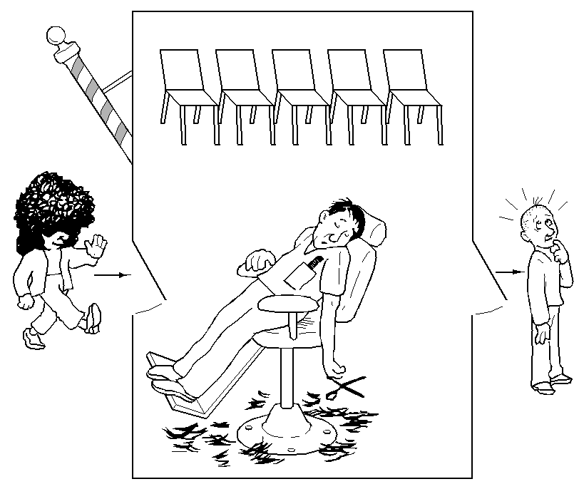
Sleeping Barber Problem
There is one barber, and n chairs for waiting customers
If there are no customers, then the barber sits in his chair and sleeps (as illustrated in the picture)
When a new customer arrives and the barber is sleeping, then he will wakeup the barber
When a new customer arrives, and the barber is busy, then he will sit on the chairs if there is any available, otherwise (when all the chairs are full) he will leave.

Slide 16
The sleeping barber problem
Barber:
  While there are people waiting for a hair cut, put one in the barber chair, and cut their hair
  When done, move to the next customer
  Else go to sleep, until someone comes in
Customer:
  If barber is asleep wake him up for a haircut
  If someone is getting a haircut wait for the barber to become free by sitting in a chair
  If all chairs are all full, leave the barbershop

Slide 17
Barber Shop Hints
Consider the following:
Customer threads should invoke a function named getHairCut.
If a customer thread arrives when the shop is full, it can invoke leave, which exits.
Barber threads should invoke cutHair.
When the barber invokes cutHair there should be exactly one thread invoking getHairCut concurrently.

Slide 18
Sleeping Barber Solution
int counts = 0;
mutex = Semaphore(1);
customer = Semaphore(0);
barber = Semaphore(0);
void customer (void){
  wait(mutex);
  if (counts==n+1) {
  signal(mutex);
  leave();
    }
  counts +=1;
  signal(mutex);
  signal(customer);
  wait(barber);
  getHairCut();
  wait(mutex);
  counts -=1;
  signal(mutex);
}
void barber (void){
wait(customer);
signal(barber);
cutHair();
}

Slide 19
End of Chapter 7

