Slide 1
Chapter 6: Synchronization Tools

Slide 2
Chapter 6: Synchronization Tools
Background
The Critical-Section Problem
Peterson’s Solution
Hardware Support for Synchronization
Mutex Locks
Semaphores
Monitors
Liveness
Evaluation

Slide 3
Objectives
Describe the critical-section problem and illustrate a race condition
Illustrate hardware solutions to the critical-section problem using memory barriers, compare-and-swap operations, and atomic variables
Demonstrate how mutex locks, semaphores, monitors, and condition variables can be used to solve the critical section problem
Evaluate tools that solve the critical-section problem in low-. Moderate-, and high-contention scenarios

Slide 4
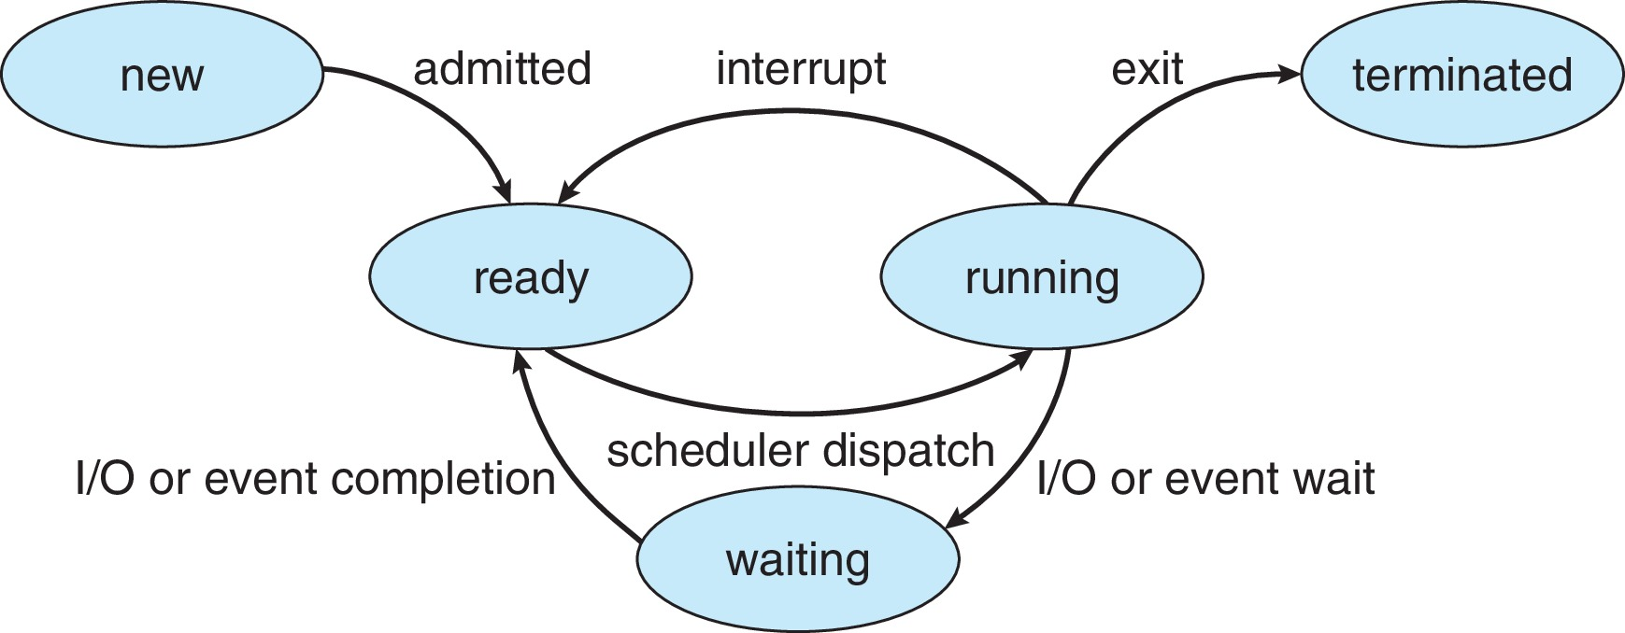
Diagram of Process State

Slide 5
Background
Processes can execute concurrently
May be interrupted at any time, partially completing execution
Concurrent access to shared data may result in data inconsistency
Maintaining data consistency requires mechanisms to ensure the orderly execution of cooperating processes
Illustration of the problem: Suppose that we wanted to provide a solution to the consumer-producer problem that fills all the buffers. We can do so by having an integer counter that keeps track of the number of full buffers. Initially, counter is set to 0. It is incremented by the producer after it produces a new buffer and is decremented by the consumer after it consumes a buffer.

Slide 6
Producer
while (true) { /* produce an item in next produced */
while (counter == BUFFER_SIZE)
; /* do nothing */
buffer[in] = next_produced;
in = (in + 1) % BUFFER_SIZE;
counter++;
}

Slide 7
Consumer
while (true) {
while (counter == 0)
; /* do nothing */
next_consumed = buffer[out];
out = (out + 1) % BUFFER_SIZE;
counter--;
/* consume the item in next consumed */
}

Slide 8
Race Condition
counter++ could be implemented as register1 = counter register1 = register1 + 1 counter = register1
counter-- could be implemented as register2 = counter register2 = register2 - 1 counter = register2
Consider this execution interleaving with “count = 5” initially:
S0: producer execute register1 = counter {register1 = 5} S1: producer execute register1 = register1 + 1 {register1 = 6} S2: consumer execute register2 = counter {register2 = 5} S3: consumer execute register2 = register2 – 1 {register2 = 4} S4: producer execute counter = register1 {counter = 6 } S5: consumer execute counter = register2 {counter = 4}

Slide 9
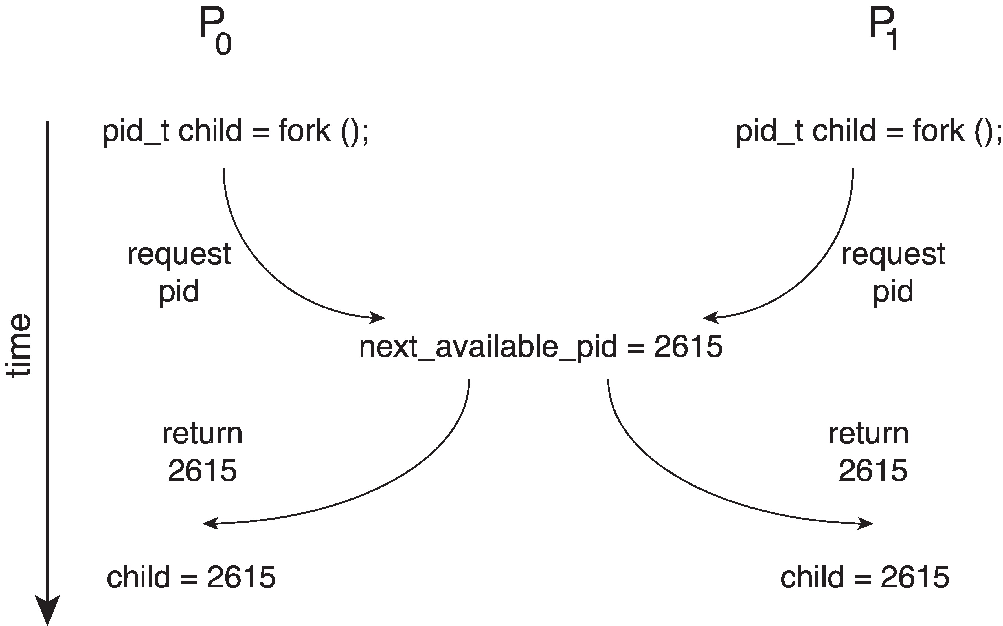
Race Condition
Processes P₀ and P₁ are creating child processs using the fork() system call
Race condition on kernel variable next_available_pid which represents the next available process identifier (pid)
Unless there is mutual exclusion, the same pid could be assigned to two different processes!

Slide 10
Critical Section Problem
Consider system of n processes {p₀, p₁, … p_{n-1}}
Each process has critical section segment of code
Process may be changing common variables, updating table, writing file, etc
When one process in critical section, no other may be in its critical section
Critical section problem is to design protocol to solve this
Each process must ask permission to enter critical section in entry section, may follow critical section with exit section, then remainder section

Slide 11
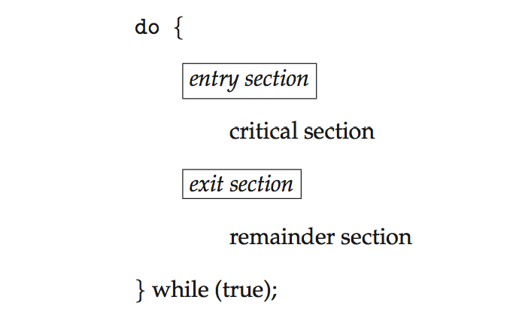
Critical Section
General structure of process P_{i}

Slide 12
Solution to Critical-Section Problem
1. Mutual Exclusion - If process P_{i} is executing in its critical section, then no other processes can be executing in their critical sections
2. Progress - If no process is executing in its critical section and there exist some processes that wish to enter their critical section, then the selection of the processes that will enter the critical section next cannot be postponed indefinitely
3. Bounded Waiting - A bound must exist on the number of times that other processes are allowed to enter their critical sections after a process has made a request to enter its critical section and before that request is granted
Assume that each process executes at a nonzero speed
No assumption concerning relative speed of the n processes

Slide 13
Critical-Section Handling in OS
Two approaches depending on if kernel is preemptive or non- preemptive
Preemptive – allows preemption of process when running in kernel mode
Non-preemptive – runs until exits kernel mode, blocks, or voluntarily yields CPU
Essentially free of race conditions in kernel mode

Slide 14
Algorithm 1
Strict Alternation
Shared variables:
int turn; initially turn = 0
turn - i ⇒ P_{i} can enter its critical section
Process P_{i}
do {
while (turn != i) ;
critical section
turn = j;
reminder section
} while (1);
Satisfies mutual exclusion, but not progress

Slide 15
Algorithm 2
Shared variables
boolean flag[2]; initially flag [0] = flag [1] = false.
flag [i] = true ⇒ P_{i} ready to enter its critical section
Process P_{i}
do {
flag[i] := true; while (flag[j]) ; critical section
flag [i] = false;
remainder section
} while (1);
Satisfies mutual exclusion, but not progress requirement.

Slide 16
Algorithm 2
Shared variables
boolean flag[2]; initially flag [0] = flag [1] = false.
flag [i] = true ⇒ P_{i} ready to enter its critical section
Process P_{i}
do {
while (flag[j]) ; flag[i] := true; critical section
flag [i] = false;
remainder section
} while (1);
mutual exclusion is not satisfied.
Swap

Slide 17
Peterson’s Solution
Not guaranteed to work on modern architectures! (But good algorithmic description of solving the problem)
Two process solution
Assume that the load and store machine-language instructions are atomic; that is, cannot be interrupted
The two processes share two variables:
int turn;
boolean flag[2]
The variable turn indicates whose turn it is to enter the critical section
The flag array is used to indicate if a process is ready to enter the critical section. flag[i] = true implies that process P_{i} is ready!

Slide 18
Algorithm for Process P_{i}
while (true){
flag[i] = true;
turn = j;
while (flag[j] && turn = = j)
;
/* critical section */
flag[i] = false;
/* remainder section */
}

Slide 19
Peterson’s Solution (Cont.)
Provable that the three CS requirement are met:
1. Mutual exclusion is preserved
P_{i} enters CS only if:
either flag[j] = false or turn = i
2. Progress requirement is satisfied
3. Bounded-waiting requirement is met

Slide 20
Peterson’s Solution
Although useful for demonstrating an algorithm, Peterson’s Solution is not guaranteed to work on modern architectures.
Understanding why it will not work is also useful for better understanding race conditions.
To improve performance, processors and/or compilers may reorder operations that have no dependencies.
For single-threaded this is ok as the result will always be the same.
For multithreaded the reordering may produce inconsistent or unexpected results!

Slide 21
Code Optimizations Wreak Havoc with Multiple Threads
// Compile with "/platform:x86 /o" and run it NOT under the debugger
internal static class StrangeBehavior { private static Boolean s_stopWorker = false; public static void Main() { Console.WriteLine("Main: letting worker run for 5 seconds"); Thread t = new Thread(Worker); t.Start(); Thread.Sleep(5000); s_stopWorker = true; Console.WriteLine("Main: waiting for worker to stop"); t.Join(); } private static void Worker(Object o) { Int32 x = 0; while (!s_stopWorker) x++; Console.WriteLine("Worker: x={0}", x); } }
// Compiler optimizes to this: Int32 x = 0; if (!s_stopWorker) while (true) x++; // Faster! Console.WriteLine("Worker: x = {0}", x);

Slide 22
Code Optimizations Cause Problems
class OutOfProgramOrder { private Boolean m_flag = false; private Int32 m_value = 0; public void Thread1() { // These could execute in reverse order m_value = 5; m_flag = true; } public void Thread2() { // m_value could be read before m_flag if (m_flag) Display(m_value); // Nothing or 5? } }

Slide 23
Peterson’s Solution
Two threads share the data: boolean flag = false; int x = 0;
Thread 1 performs while (!flag) ; print x
Thread 2 performs x = 100; flag = true
What is the expected output?

Slide 24
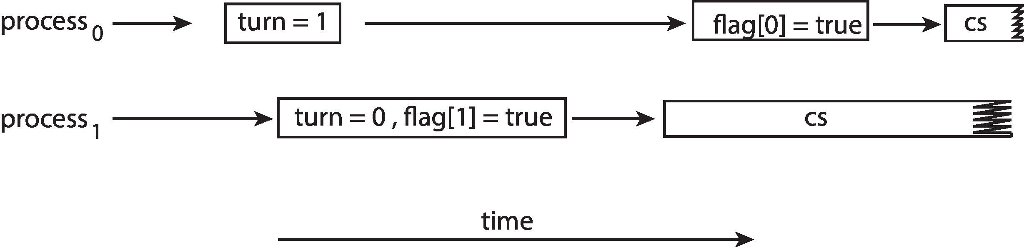
Peterson’s Solution
100 is the expected output.
However, the operations for Thread 2 may be reordered: flag = true; x = 100;
If this occurs, the output may be 0!
The effects of instruction reordering in Peterson’s Solution
This allows both processes to be in their critical section at the same time!

Slide 25
Synchronization Hardware
Many systems provide hardware support for implementing the critical section code.
Uniprocessors – could disable interrupts
Currently running code would execute without preemption
Generally too inefficient on multiprocessor systems
Operating systems using this not broadly scalable
We will look at three forms of hardware support: 1. Memory barriers 2. Hardware instructions 3. Atomic variables

Slide 26
Memory Barriers
Memory model are the memory guarantees a computer architecture makes to application programs.
Memory models may be either:
Strongly ordered – where a memory modification of one processor is immediately visible to all other processors.
Weakly ordered – where a memory modification of one processor may not be immediately visible to all other processors.
A memory barrier is an instruction that forces any change in memory to be propagated (made visible) to all other processors.

Slide 27
Memory Barrier
We could add a memory barrier to the following instructions to ensure Thread 1 outputs 100:
Thread 1 now performs while (!flag) memory_barrier(); print x
Thread 2 now performs x = 100; memory_barrier(); flag = true

Slide 28
Hardware Instructions
Special hardware instructions that allow us to either test-and-modify the content of a word, or to swap the contents of two words atomically (uninterruptibly.)
Test-and-Set instruction
Compare-and-Swap instruction

Slide 29
test_and_set Instruction
Definition:
boolean test_and_set (boolean *target)
{
boolean rv = *target;
*target = true;
return rv:
}
Executed atomically
Returns the original value of passed parameter
Set the new value of passed parameter to true

Slide 30
Solution using test_and_set()
Shared boolean variable lock, initialized to false
Solution:
do { while (test_and_set(&lock))
; /* do nothing */
/* critical section */
lock = false;
/* remainder section */
} while (true);

Slide 31
compare_and_swap Instruction
Definition:
int compare _and_swap(int *value, int expected, int new_value) {
int temp = *value;
if (*value == expected)
*value = new_value;
return temp;
}
Executed atomically
Returns the original value of passed parameter value
Set the variable value the value of the passed parameter new_value but only if *value == expected is true. That is, the swap takes place only under this condition.

Slide 32
Solution using compare_and_swap
Shared integer lock initialized to 0;
Solution:
while (true){ while (compare_and_swap(&lock, 0, 1) != 0)
; /* do nothing */
/* critical section */
lock = 0;
/* remainder section */
}

Slide 33
Bounded-waiting Mutual Exclusion with compare-and-swap
while (true) { waiting[i] = true; key = 1; while (waiting[i] && key == 1)
key = compare_and_swap(&lock,0,1);
waiting[i] = false;
/* critical section */
j = (i + 1) % n;
while ((j != i) && !waiting[j])
j = (j + 1) % n;
if (j == i)
lock = 0;
else
waiting[j] = false;
/* remainder section */
}

Slide 34
Atomic Variables
Typically, instructions such as compare-and-swap are used as building blocks for other synchronization tools.
One tool is an atomic variable that provides atomic (uninterruptible) updates on basic data types such as integers and booleans.
For example, the increment() operation on the atomic variable sequence ensures sequence is incremented without interruption: increment(&sequence);

Slide 35
Atomic Variables
The increment() function can be implemented as follows: void increment(atomic_int *v) { int temp; do { temp = *v; } while (temp != (compare_and_swap(v,temp,temp+1)); }

Slide 36
Manipulating an Int32 Atomically
public static class Interlocked { // return (++location); public static Int32 Increment(ref Int32 location); // return (–-location); public static Int32 Decrement(ref Int32 location); // return (location += value); // Note: value can be a negative number allowing subtraction public static Int32 Add(ref Int32 location, Int32 value); // Int32 old = location; location = value; return old; public static Int32 Exchange(ref Int32 location, Int32 value); // Int32 old = location; // if (location == comparand) location = value // return old; public static Int32 CompareExchange(ref Int32 location, Int32 value, Int32 comparand);
}
Each Interlocked method is a full memory fence

Slide 37
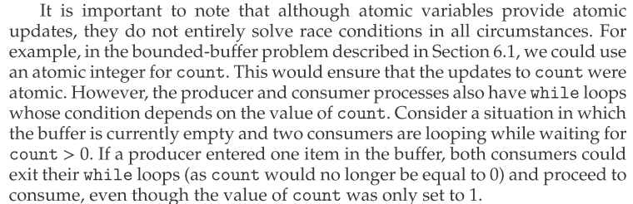
Atomic Variables

Slide 38
Mutex Locks
Previous solutions are complicated and generally inaccessible to application programmers
OS designers build software tools to solve critical section problem
Simplest is mutex lock
Protect a critical section by first acquire() a lock then release() the lock
Boolean variable indicating if lock is available or not
Calls to acquire() and release() must be atomic
Usually implemented via hardware atomic instructions such as compare-and-swap.
But this solution requires busy waiting
This lock therefore called a spinlock

Slide 39
Solution to Critical-section Problem Using Locks
while (true) {
acquire lock
critical section
release lock
remainder section
}

Slide 40
Mutex Lock Definitions
acquire() { while (!available)
; /* busy wait */
available = false;;
}
release() {
available = true;
}
These two functions must be implemented atomically.
Both test-and-set and compare-and-swap can be used to implement these functions.

Slide 41
Semaphore
Synchronization tool that provides more sophisticated ways (than Mutex locks) for process to synchronize their activities.
Semaphore S – integer variable
Can only be accessed via two indivisible (atomic) operations
wait() and signal()
(Originally called P() and V())
Definition of the wait() operation
wait(S) {
while (S <= 0)
; // busy wait
S--;
}
Definition of the signal() operation
signal(S) {
S++;
}

Slide 42
Semaphore Usage
Counting semaphore – integer value can range over an unrestricted domain
Binary semaphore – integer value can range only between 0 and 1
Same as a mutex lock
Can solve various synchronization problems
Consider P₁ and P₂ that require S₁ to happen before S₂
Create a semaphore “synch” initialized to 0
P1:
S₁;
signal(synch);
P2:
wait(synch);
S₂;
Can implement a counting semaphore S as a binary semaphore

Slide 43
Semaphore Implementation
Must guarantee that no two processes can execute the wait() and signal() on the same semaphore at the same time
Thus, the implementation becomes the critical section problem where the wait and signal code are placed in the critical section
Could now have busy waiting in critical section implementation
But implementation code is short
Little busy waiting if critical section rarely occupied
Note that applications may spend lots of time in critical sections and therefore this is not a good solution

Slide 44
Semaphore Implementation with no Busy waiting
With each semaphore there is an associated waiting queue
Each entry in a waiting queue has two data items:
value (of type integer)
pointer to next record in the list
Two operations:
block – place the process invoking the operation on the appropriate waiting queue
wakeup – remove one of processes in the waiting queue and place it in the ready queue
typedef struct {
int value;
struct process *list;
} semaphore;

Slide 45
Implementation with no Busy waiting (Cont.)
wait(semaphore *S) {
S->value--;
if (S->value < 0) { add this process to S->list;
block();
}
}
signal(semaphore *S) {
S->value++;
if (S->value <= 0) { remove a process P from S->list;
wakeup(P);
}
}

Slide 46
Problems with Semaphores
Incorrect use of semaphore operations:
signal (mutex) …. wait (mutex)
wait (mutex) … wait (mutex)
Omitting of wait (mutex) and/or signal (mutex)
These – and others – are examples of what can occur when sempahores and other synchronization tools are used incorrectly.

Slide 47
Monitors
A high-level abstraction that provides a convenient and effective mechanism for process synchronization
Abstract data type, internal variables only accessible by code within the procedure
Only one process may be active within the monitor at a time
Pseudocode syntax of a monitor:
monitor monitor-name
{
// shared variable declarations
function P1 (…) { …. }
function P2 (…) { …. }
function Pn (…) {……}
initialization code (…) { … }
}

Slide 48
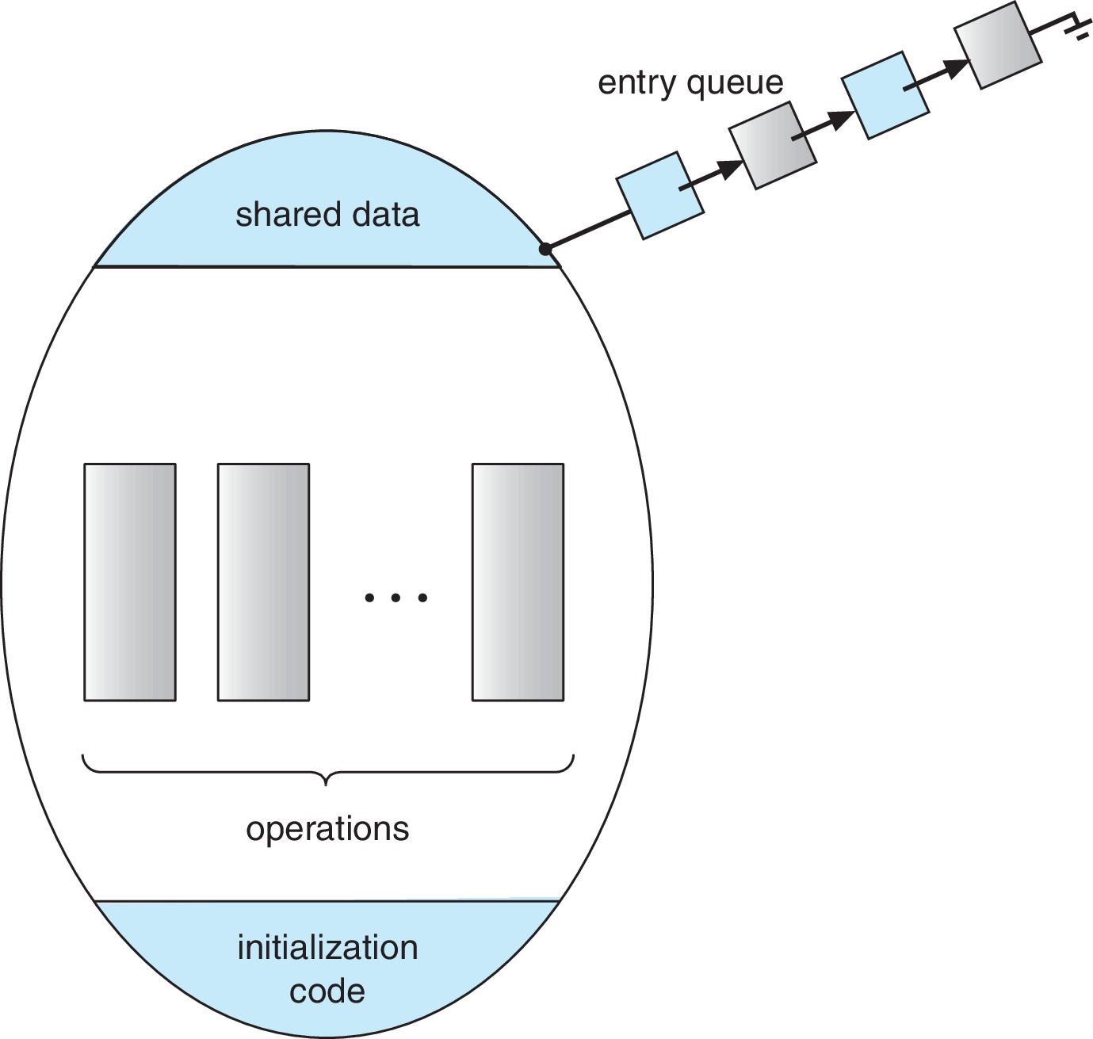
Schematic view of a Monitor

Slide 49
Condition Variables
condition x, y;
Two operations are allowed on a condition variable:
x.wait() – a process that invokes the operation is suspended until x.signal()
x.signal() – resumes one of processes (if any) that invoked x.wait()
If no x.wait() on the variable, then it has no effect on the variable

Slide 50
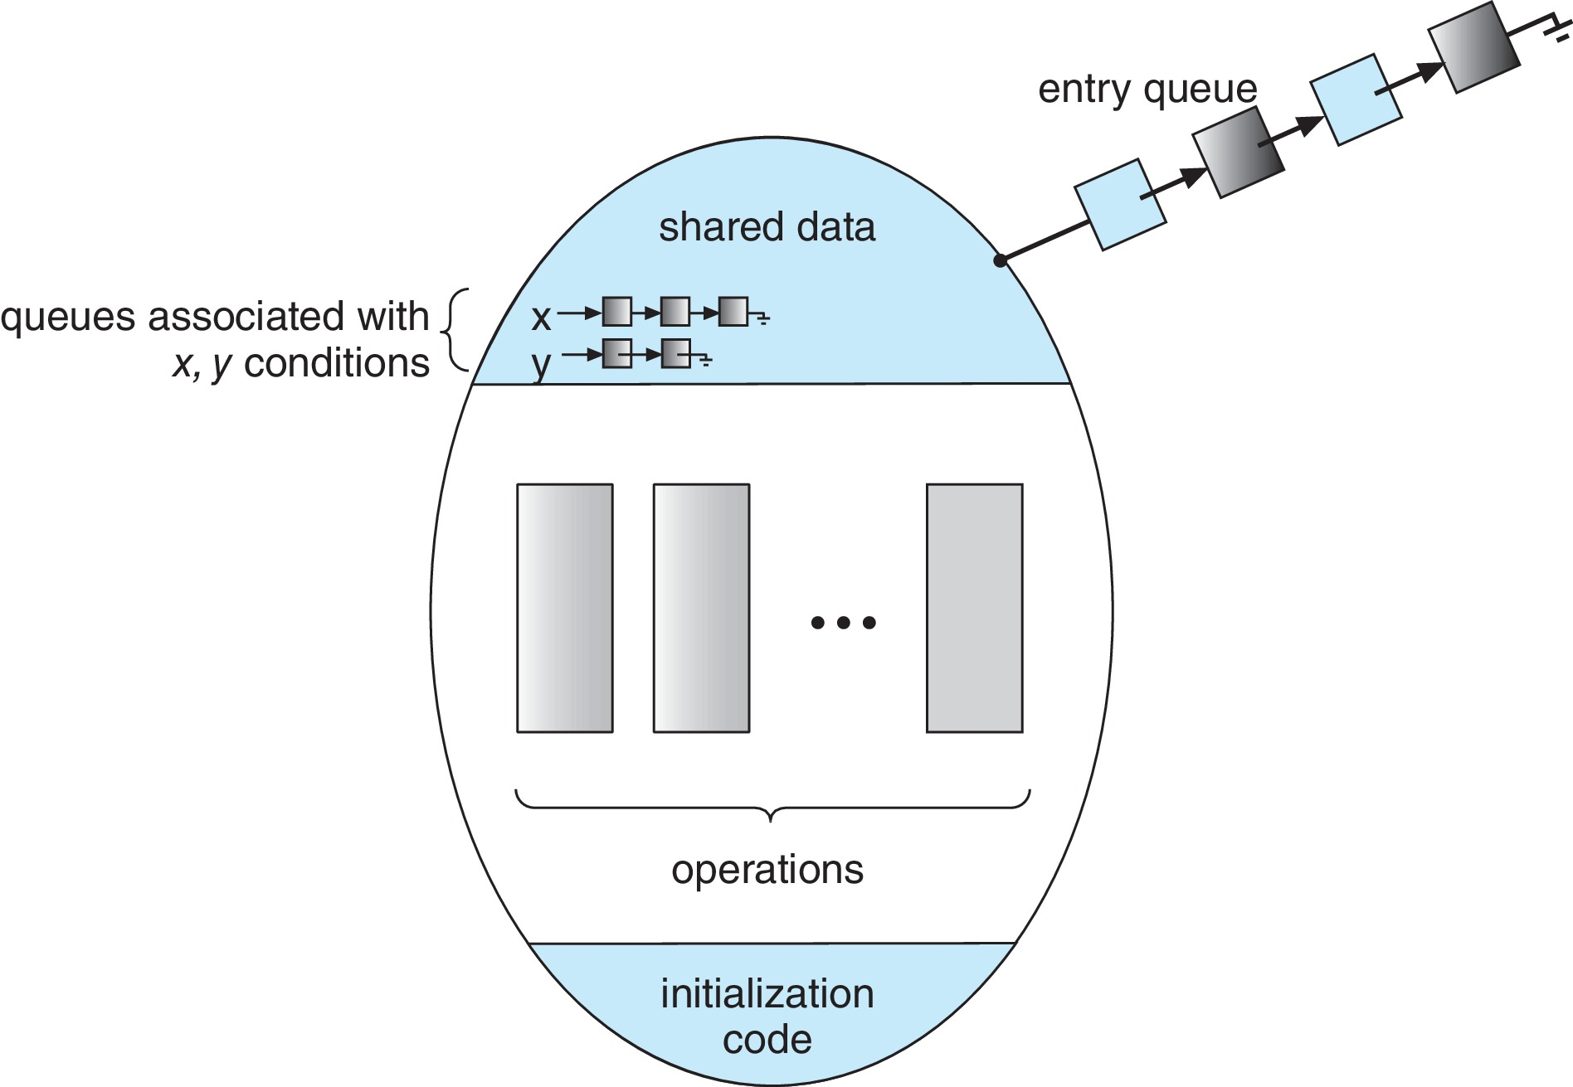
Monitor with Condition Variables

Slide 51
Condition Variables Choices
If process P invokes x.signal(), and process Q is suspended in x.wait(), what should happen next?
Both Q and P cannot execute in paralel. If Q is resumed, then P must wait
Options include
Signal and wait – P waits until Q either leaves the monitor or it waits for another condition
Signal and continue – Q waits until P either leaves the monitor or it waits for another condition
Both have pros and cons – language implementer can decide
Monitors implemented in Concurrent Pascal compromise
P executing signal immediately leaves the monitor, Q is resumed
Implemented in other languages including Mesa, C#, Java

Slide 52
Monitor Implementation Using Semaphores
Variables
semaphore mutex; // (initially = 1)
semaphore next; // (initially = 0)
int next_count = 0;
Each function F will be replaced by
wait(mutex);
…
body of F;
…
if (next_count > 0)
signal(next)
else
signal(mutex);
Mutual exclusion within a monitor is ensured

Slide 53
Monitor Implementation – Condition Variables
For each condition variable x, we have:
semaphore x_sem; // (initially = 0)
int x_count = 0;
The operation x.wait() can be implemented as:
x_count++;
if (next_count > 0)
signal(next);
else
signal(mutex);
wait(x_sem);
x_count--;

Slide 54
Monitor Implementation (Cont.)
The operation x.signal() can be implemented as:
if (x_count > 0) {
next_count++;
signal(x_sem);
wait(next);
next_count--;
}

Slide 55
Resuming Processes within a Monitor
If several processes queued on condition variable x, and x.signal() is executed, which process should be resumed?
FCFS frequently not adequate
conditional-wait construct of the form x.wait(c)
Where c is priority number
Process with lowest number (highest priority) is scheduled next

Slide 56
Single Resource allocation
Allocate a single resource among competing processes using priority numbers that specify the maximum time a process plans to use the resource
R.acquire(t);
...
access the resurce;
...
R.release;
Where R is an instance of type ResourceAllocator

Slide 57
A Monitor to Allocate Single Resource
monitor ResourceAllocator
{
boolean busy;
condition x;
void acquire(int time) {
if (busy)
x.wait(time);
busy = true;
}
void release() {
busy = FALSE;
x.signal();
}
initialization code() {
busy = false;
}
}

Slide 58
Liveness
Processes may have to wait indefinitely while trying to acquire a synchronization tool such as a mutex lock or semaphore.
Waiting indefinitely violates the progress and bounded-waiting criteria discussed at the beginning of this chapter.
Liveness refers to a set of properties that a system must satisfy to ensure processes make progress.
Indefinite waiting is an example of a liveness failure.

Slide 59
Liveness
Deadlock – two or more processes are waiting indefinitely for an event that can be caused by only one of the waiting processes
Let S and Q be two semaphores initialized to 1
P₀ P₁
wait(S); wait(Q);
wait(Q); wait(S);
... ...
signal(S); signal(Q);
signal(Q); signal(S);
Consider if P₀ executes wait(S) and P₁ wait(Q). When P₀ executes wait(Q), it must wait until P₁ executes signal(Q)
However, P₁ is waiting until P₀ execute signal(S).
Since these signal() operations will never be executed, P₀ and P₁ are deadlocked.

Slide 60
Liveness
Other forms of deadlock:
Starvation – indefinite blocking
A process may never be removed from the semaphore queue in which it is suspended
Priority Inversion – Scheduling problem when lower-priority process holds a lock needed by higher-priority process
Solved via priority-inheritance protocol

Slide 61
Priority Inheritance Protocol
Consider the scenario with three processes P1, P2, and P3. P1 has the highest priority, P2 the next highest, and P3 the lowest. Assume a resouce P3 is assigned a resource R that P1 wants. Thus, P1 must wait for P3 to finish using the resource. However, P2 becomes runnable and preempts P3. What has happened is that P2 - a process with a lower priority than P1 - has indirectly prevented P3 from gaining access to the resource.
To prevent this from occurring, a priority inheritance protocol is used. This simply allows the priority of the highest thread waiting to access a shared resource to be assigned to the thread currently using the resource. Thus, the current owner of the resource is assigned the priority of the highest priority thread wishing to acquire the resource.

Slide 62
End of Chapter 6

