Slide 1
CS-342 ( Operating Systems 2)
Lecture 1
Course Introduction & Plan
Fall 2023 (Semester 1)
Week 1
Dr. Mohammed El-Said
Assistant Professor, Computer Science Dept.,
Faculty of Computers & Artificial Intelligence,
Helwan University - Cairo, Egypt.

Slide 2
Outline
Course Details
Course Staff: Instructors (Short Bio)
Topics & Learning Objectives
Learning Objectives of this Course
Topics Covered
Course Logistics
Course Materials & Announcements
Assessment Summary (Grading Policy)
Outline
2

Slide 3
Course Details
Course Code CS342
Course Name Operating Systems 2
Coordinating Unit Computer Science Department,
Faculty of Computers & Artificial Intelligence, Helwan University
Term Semester 1 (Fall)
Level Undergraduate - Levels 3, 4

Slide 4
Course Staff: Instructors (Short Bio)
( CS 342 Operating Systems 2 )
Dr. Mohammed El-Said
Bachelor in Computer Science from Helwan University
Masters in Computer Science from Helwan University
PhD. in Computer Science (Computational Linguistics) from Helwan University

Slide 5

Topics Covered Learning Objectives .. of this course

Slide 6
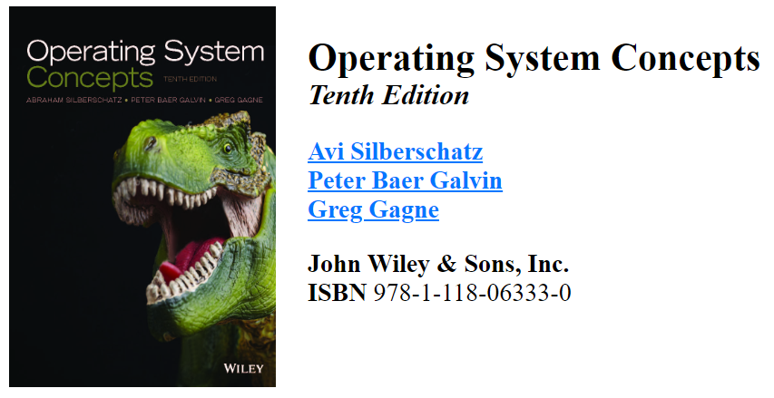
Textbook

Slide 7
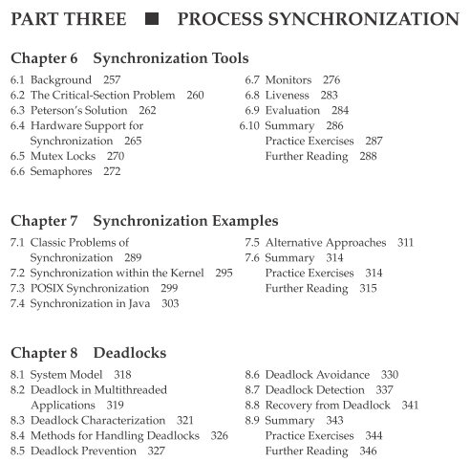

Slide 8
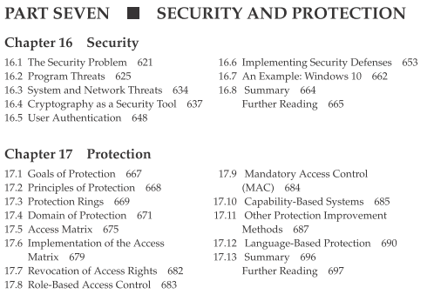

Slide 9
Chapter 6: Synchronization Tools
Background
The Critical-Section Problem
Peterson’s Solution
Hardware Support for Synchronization
Mutex Locks
Semaphores
Monitors
Liveness
Evaluation

Slide 10
Chapter 7: Synchronization Examples
Classical problems used to test newly-proposed synchronization schemes
Bounded-Buffer Problem
Readers and Writers Problem
Dining-Philosophers Problem

Slide 11
Chapter 8: Deadlocks
System Model
Deadlock in Multithreaded Applications
Deadlock Characterization
Methods for Handling Deadlocks
Deadlock Prevention
Deadlock Avoidance
Deadlock Detection
Recovery from Deadlock

Slide 12
Chapter 16: Security
The Security Problem
Program Threats
System and Network Threats
Cryptography as a Security Tool
User Authentication
Implementing Security Defenses
Firewalling to Protect Systems and Networks
Computer-Security Classifications

Slide 13
Chapter 17: Protection
Goals of Protection
Principles of Protection
Protection Rings
Domain of Protection
Access Matrix
Implementation of Access Matrix
Revocation of Access Rights
Role-based Access Control
Mandatory Access Control (MAC)
Capability-Based Systems
Other Protection Implementation Methods
Language-based Protection

Slide 14
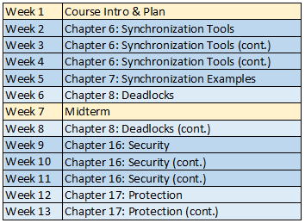
Agenda

Slide 15
Section Materials
Threading using Java

Slide 16
Course Logistics

Slide 17

Course Materials & Announcements
Course Webpage
fcai.smartpharaohs.com/os2/2023
Announcements, and any supplemental notes will be made available “posted” online on the MS Teams Group
xpsfpy4

Slide 18
Assessment Summary (Grading Policy)
The Assessment for this subject consists of five components with the following weightings (grading breakdown):
Final Written Exam 50%
Midterm Exam 20%
Two Sheets 10%
Two Programming Assignments 10%
Project 10%

Slide 19
Thanks! .. Questions?

