Slide 1
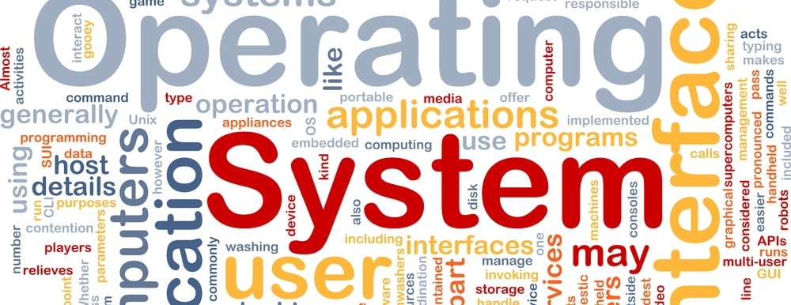
Operating Systems 2
Programming Assignment 2
Prepared by:
Eng. Abdalla Essam Abdalla

Slide 2
Banker’s algorithm
You will write a program that implements the banker’s algorithm discussed in the lecture
Customers request and release resources from the bank.
The banker will grant a request only if it leaves the system in a safe state.
A request that leaves the system in an unsafe state will be denied.

Slide 3
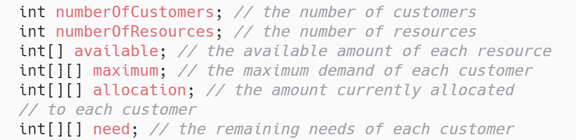

BankImpl (aka Banker)
The BankImpl (aka Banker)
The banker will consider requests from $n$ customers for $m$ resources types
The banker will keep track of the resources using the following data structures:

Slide 4
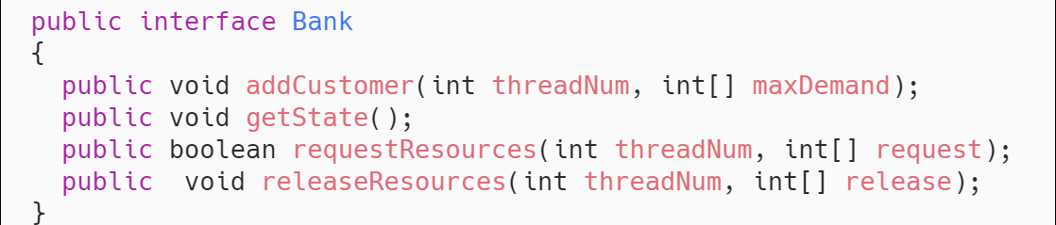
BankImpl (aka Banker)
The functionality of the Banker appears in the Bank interface
The implementation of this interface will require
adding a constructor that is passed the number of resources initially available
The banker will grant a request if the request satisfies the safety algorithm outlined in lecture.
If granting the request does not leave the system in a safe state, the request is denied.

Slide 5
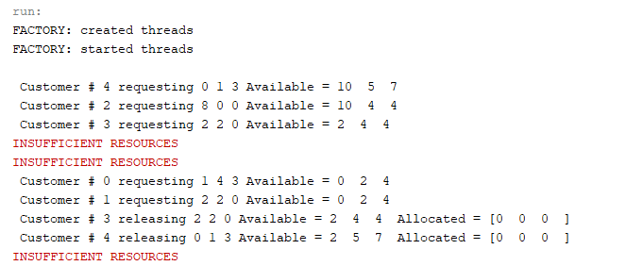
BankImpl (aka Banker)

