Slide 1

Operating Systems 2
Programming Assignment 1
Prepared by:
Eng. Abdalla Essam Abdalla

Slide 2
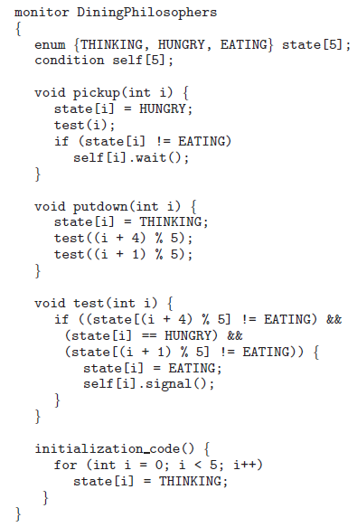
Dining Philosophers Problem
The image on the right shows the solution to the dining philosopher problem using monitor.
In this assignment you are asked to implement this solution using Java
You must use Java’s conditional variables
Using synchronized methods/blocks is forbidden
Notes:
The solution to be implemented impose the restriction that a philosopher may pick his chopsticks only if both of them are available.
There states a philosopher may be found in:
Thinking
Hungry
Eating
Philosopher $i$ can set the variable state[i] = eating only if his two neighbors are not eating
State[(i+4)%5] != Eating && State[(i+1) % 5 ] != Eating
You will need to use conditional variables to be able to delay a specific philosopher

Slide 3
Starter code
You are given a repo with the following classes
DiningPhilosophers.java This is the driver class which create and execute threads
Philosopher.java This class represents each philosopher thread.
DiningServer.java An interface class that contains the methods called by the philosophers
DiningServerImpl.java Your task is to implement this class:
It implements the DiningPhilosophers interface
An object of this class is shared between all philosopher and is used for synchronization
SleepUtilities.java A helper class used by philosophers to take a nap

Slide 4
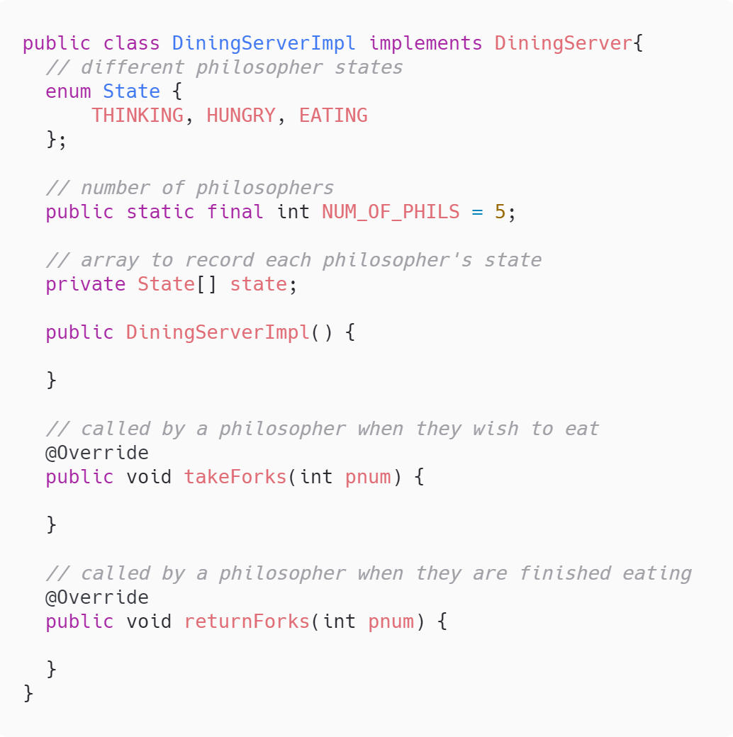
DiningServerImpl.java
You should implement all the abstract methods.
You should implement and use the following methods:
test(int i)
Test if philosopher want and can eat
Update its state
Do any other required processing
leftNeighbor(int i)
rightNeighbor(int i)

