Slide 1
Chapter 1 Introduction to Computers, Programs, and Java

Slide 2
Objectives
To understand computer basics, programs, and operating systems (§§1.2–1.4).
To describe the relationship between Java and the World Wide Web (§1.5).
To understand the meaning of Java language specification, API, JDK, and IDE (§1.6).
To write a simple Java program (§1.7).
To display output on the console (§1.7).
To explain the basic syntax of a Java program (§1.7).
To create, compile, and run Java programs (§1.8).
To use sound Java programming style and document programs properly (§1.9).
To explain the differences between syntax errors, runtime errors, and logic errors (§1.10).
To develop Java programs using NetBeans (§1.11).
To develop Java programs using Eclipse (§1.12).

Slide 3
What is a Computer?
A computer consists of a CPU, memory, hard disk, floppy disk, monitor, printer, and communication devices.

Slide 4
CPU
The central processing unit (CPU) is the brain of a computer. It retrieves instructions from memory and executes them. The unit of measurement of clock speed is the hertz (Hz), with 1 hertz equaling 1 pulse per second. In the 1990s, computers measured clock speed in megahertz (MHz), but CPU speed has been improving continuously; the clock speed of a computer is now usually stated in gigahertz (GHz). Intel’s newest processors run at about 3 GHz.

Slide 5
Memory
Memory is to store data and program instructions for CPU to execute. A memory unit is an ordered sequence of bytes, each holds eight bits. A program and its data must be brought to memory before they can be executed. A memory byte is never empty, but its initial content may be meaningless to your program. The current content of a memory byte is lost whenever new information is placed in it.

Slide 6
How Data is Stored?
Data of various kinds, such as numbers, characters, and strings, are encoded as a series of bits (zeros and ones). Computers use zeros and ones because digital devices have two stable states, which are referred to as zero and one by convention. The programmers need not to be concerned about the encoding and decoding of data, which is performed automatically by the system based on the encoding scheme. The encoding scheme varies. For example, character ‘J’ is represented by 01001010 in one byte. A small number such as three can be stored in a single byte. If computer needs to store a large number that cannot fit into a single byte, it uses a number of adjacent bytes. No two data can share or split a same byte. A byte is the minimum storage unit.

Slide 7
Storage Devices
Memory is volatile, because information is lost when the power is off. Programs and data are permanently stored on storage devices and are moved to memory when the computer actually uses them. There are three main types of storage devices: Disk drives (hard disks), CD drives (CD-R and CD-RW), and USB flash drives.

Slide 8
Output Devices: Monitor
The monitor displays information (text and graphics). The resolution and dot pitch determine the quality of the display.

Slide 9
Monitor Resolution and Dot Pitch
resolution
The screen resolution specifies the number of pixels in horizontal and vertical dimensions of the display device. Pixels (short for “picture elements”) are tiny dots that form an image on the screen. A common resolution for a 17-inch screen, for example, is 1,024 pixels wide and 768 pixels high. The resolution can be set manually. The higher the resolution, the sharper and clearer the image is.
dot pitch
The dot pitch is the amount of space between pixels, measured in millimeters. The smaller the dot pitch, the sharper the display.

Slide 10
Communication Devices
A regular modem uses a phone line and can transfer data in a speed up to 56,000 bps (bits per second). A DSL (digital subscriber line) also uses a phone line and can transfer data in a speed 20 times faster than a regular modem. A cable modem uses the TV cable line maintained by the cable company. A cable modem is as fast as a DSL. Network interface card (NIC) is a device to connect a computer to a local area network (LAN). The LAN is commonly used in business, universities, and government organizations. A high-speed NIC, called 1000BaseT, can transfer data at 1000 mbps (million bits per second).

Slide 11
Programs
Computer programs, known as software, are instructions to the computer.
You tell a computer what to do through programs. Without programs, a computer is an empty machine. Computers do not understand human languages, so you need to use computer languages to communicate with them.
Programs are written using programming languages.

Slide 12
Programming Languages
Machine Language Assembly Language High-Level Language
Machine language is a set of primitive instructions built into every computer. The instructions are in the form of binary code, so you have to enter binary codes for various instructions. Program with native machine language is a tedious process. Moreover the programs are highly difficult to read and modify. For example, to add two numbers, you might write an instruction in binary like this:
  1101101010011010

Slide 13
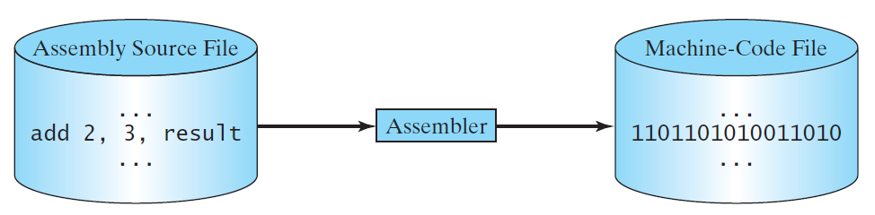
Programming Languages
Machine Language Assembly Language High-Level Language
Assembly languages were developed to make programming easy. Since the computer cannot understand assembly language, however, a program called assembler is used to convert assembly language programs into machine code. For example, to add two numbers, you might write an instruction in assembly code like this:
ADDF3 R1, R2, R3

Slide 14
Programming Languages
Machine Language Assembly Language High-Level Language
The high-level languages are English-like and easy to learn and program. For example, the following is a high-level language statement that computes the area of a circle with radius 5:
area = 5 * 5 * 3.1415;

Slide 15
Popular High-Level Languages

Slide 16
Interpreting/Compiling Source Code
A program written in a high-level language is called a source program or source code. Because a computer cannot understand a source program, a source program must be translated into machine code for execution. The translation can be done using another programming tool called an interpreter or a compiler.

Slide 17
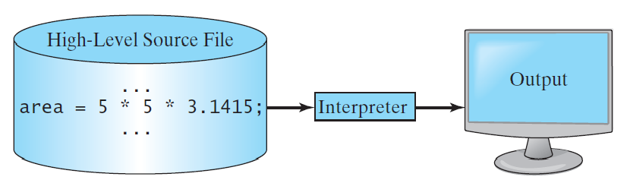
Interpreting Source Code
An interpreter reads one statement from the source code, translates it to the machine code or virtual machine code, and then executes it right away, as shown in the following figure. Note that a statement from the source code may be translated into several machine instructions.

Slide 18
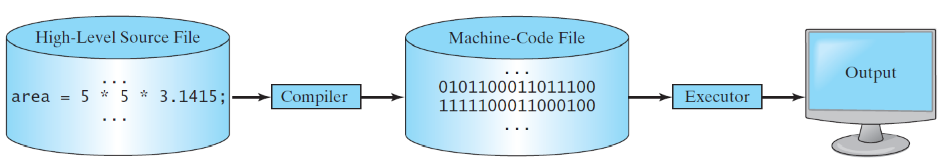
Compiling Source Code
A compiler translates the entire source code into a machine-code file, and the machine-code file is then executed, as shown in the following figure.

Slide 19
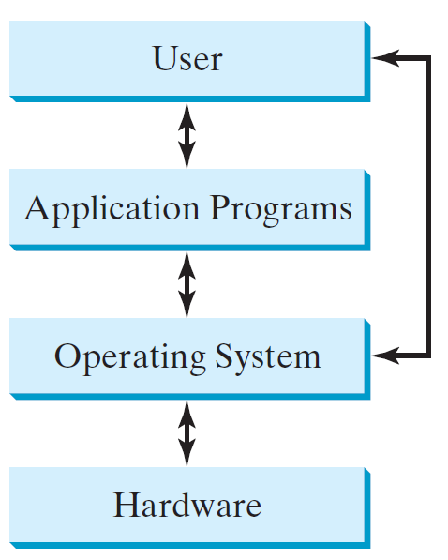
Operating Systems
The operating system (OS) is a program that manages and controls a computer’s activities. The popular operating systems for general-purpose computers are Microsoft Windows, Mac OS, and Linux. Application programs, such as a Web browser or a word processor, cannot run unless an operating system is installed and running on the computer.

Slide 20
Why Java?
The answer is that Java enables users to develop and deploy applications on the Internet for servers, desktop computers, and small hand-held devices. The future of computing is being profoundly influenced by the Internet, and Java promises to remain a big part of that future. Java is the Internet programming language.
Java is a general purpose programming language.
Java is the Internet programming language.

Slide 21
Java, Web, and Beyond
Java can be used to develop standalone applications.
Java can be used to develop applications running from a browser.
Java can also be used to develop applications for hand-held devices.
Java can be used to develop applications for Web servers.

Slide 22
Java’s History
James Gosling and Sun Microsystems
Oak
Java, May 20, 1995, Sun World
HotJava
  The first Java-enabled Web browser
Early History Website:
http://www.java.com/en/javahistory/index.jsp

Slide 23
Characteristics of Java
Companion Website
Java Is Simple
Java Is Object-Oriented
Java Is Distributed
Java Is Interpreted
Java Is Robust
Java Is Secure
Java Is Architecture-Neutral
Java Is Portable
Java's Performance
Java Is Multithreaded
Java Is Dynamic
https://liveexample.pearsoncmg.com/etc/JavaCharacteristics.pdf

Slide 24
Characteristics of Java
Companion Website
Java Is Simple
Java Is Object-Oriented
Java Is Distributed
Java Is Interpreted
Java Is Robust
Java Is Secure
Java Is Architecture-Neutral
Java Is Portable
Java's Performance
Java Is Multithreaded
Java Is Dynamic
Java is partially modeled on C++, but greatly simplified and improved. Some people refer to Java as "C++--" because it is like C++ but with more functionality and fewer negative aspects.

Slide 25
Characteristics of Java
Companion Website
Java Is Simple
Java Is Object-Oriented
Java Is Distributed
Java Is Interpreted
Java Is Robust
Java Is Secure
Java Is Architecture-Neutral
Java Is Portable
Java's Performance
Java Is Multithreaded
Java Is Dynamic
Java is inherently object-oriented. Although many object-oriented languages began strictly as procedural languages, Java was designed from the start to be object-oriented. Object-oriented programming (OOP) is a popular programming approach that is replacing traditional procedural programming techniques.
One of the central issues in software development is how to reuse code. Object-oriented programming provides great flexibility, modularity, clarity, and reusability through encapsulation, inheritance, and polymorphism.

Slide 26
Characteristics of Java
Companion Website
Java Is Simple
Java Is Object-Oriented
Java Is Distributed
Java Is Interpreted
Java Is Robust
Java Is Secure
Java Is Architecture-Neutral
Java Is Portable
Java's Performance
Java Is Multithreaded
Java Is Dynamic
Distributed computing involves several computers working together on a network. Java is designed to make distributed computing easy. Since networking capability is inherently integrated into Java, writing network programs is like sending and receiving data to and from a file.

Slide 27
Characteristics of Java
Companion Website
Java Is Simple
Java Is Object-Oriented
Java Is Distributed
Java Is Interpreted
Java Is Robust
Java Is Secure
Java Is Architecture-Neutral
Java Is Portable
Java's Performance
Java Is Multithreaded
Java Is Dynamic
You need an interpreter to run Java programs. The programs are compiled into the Java Virtual Machine code called bytecode. The bytecode is machine-independent and can run on any machine that has a Java interpreter, which is part of the Java Virtual Machine (JVM).

Slide 28
Characteristics of Java
Companion Website
Java Is Simple
Java Is Object-Oriented
Java Is Distributed
Java Is Interpreted
Java Is Robust
Java Is Secure
Java Is Architecture-Neutral
Java Is Portable
Java's Performance
Java Is Multithreaded
Java Is Dynamic
Java compilers can detect many problems that would first show up at execution time in other languages.
Java has eliminated certain types of error-prone programming constructs found in other languages.
Java has a runtime exception-handling feature to provide programming support for robustness.

Slide 29
Characteristics of Java
Companion Website
Java Is Simple
Java Is Object-Oriented
Java Is Distributed
Java Is Interpreted
Java Is Robust
Java Is Secure
Java Is Architecture-Neutral
Java Is Portable
Java's Performance
Java Is Multithreaded
Java Is Dynamic
Java implements several security mechanisms to protect your system against harm caused by stray programs.

Slide 30
Characteristics of Java
Companion Website
Java Is Simple
Java Is Object-Oriented
Java Is Distributed
Java Is Interpreted
Java Is Robust
Java Is Secure
Java Is Architecture-Neutral
Java Is Portable
Java's Performance
Java Is Multithreaded
Java Is Dynamic
Write once, run anywhere
With a Java Virtual Machine (JVM), you can write one program that will run on any platform.

Slide 31
Characteristics of Java
Companion Website
Java Is Simple
Java Is Object-Oriented
Java Is Distributed
Java Is Interpreted
Java Is Robust
Java Is Secure
Java Is Architecture-Neutral
Java Is Portable
Java's Performance
Java Is Multithreaded
Java Is Dynamic
Because Java is architecture neutral, Java programs are portable. They can be run on any platform without being recompiled.

Slide 32
Characteristics of Java
Companion Website
Java Is Simple
Java Is Object-Oriented
Java Is Distributed
Java Is Interpreted
Java Is Robust
Java Is Secure
Java Is Architecture-Neutral
Java Is Portable
Java's Performance
Java Is Multithreaded
Java Is Dynamic
Java’s performance has been improved impressively over the years with every new version.

Slide 33
Characteristics of Java
Companion Website
Java Is Simple
Java Is Object-Oriented
Java Is Distributed
Java Is Interpreted
Java Is Robust
Java Is Secure
Java Is Architecture-Neutral
Java Is Portable
Java's Performance
Java Is Multithreaded
Java Is Dynamic
Multithread programming is smoothly integrated in Java, whereas in other languages you have to call procedures specific to the operating system to enable multithreading.

Slide 34
Characteristics of Java
Companion Website
Java Is Simple
Java Is Object-Oriented
Java Is Distributed
Java Is Interpreted
Java Is Robust
Java Is Secure
Java Is Architecture-Neutral
Java Is Portable
Java's Performance
Java Is Multithreaded
Java Is Dynamic
Java was designed to adapt to an evolving environment. New code can be loaded on the fly without recompilation. There is no need for developers to create, and for users to install, major new software versions. New features can be incorporated transparently as needed.

Slide 35
JDK Versions
JDK 1.02 (1995)
JDK 1.1 (1996)
JDK 1.2 (1998)
JDK 1.3 (2000)
JDK 1.4 (2002)
JDK 1.5 (2004) a. k. a. JDK 5 or Java 5
JDK 1.6 (2006) a. k. a. JDK 6 or Java 6
JDK 1.7 (2011) a. k. a. JDK 7 or Java 7
JDK 1.8 (2014) a. k. a. JDK 8 or Java 8
Java 9, 10, 11, 12, 13, 14.

Slide 36
JDK Editions
Java Standard Edition (J2SE)
  J2SE can be used to develop client-side standalone applications or applets.
Java Enterprise Edition (J2EE)
  J2EE can be used to develop server-side applications such as Java servlets, Java ServerPages, and Java ServerFaces.
Java Micro Edition (J2ME).
  J2ME can be used to develop applications for mobile devices such as cell phones.
This book uses J2SE to introduce Java programming.

Slide 37
Popular Java IDEs
NetBeans
Eclipse

Slide 38
A Simple Java Program
Listing 1.1
// This program prints Welcome to Java!
public class Welcome {
public static void main(String[] args) {
System.out.println("Welcome to Java!");
}
}
Note: Clicking the green button displays the source code with interactive animation. You can also run the code in a browser. Internet connection is needed for this button.
Welcome

Slide 39
Trace a Program Execution
animation
Enter main method
// This program prints Welcome to Java!
public class Welcome {
public static void main(String[] args) {
System.out.println("Welcome to Java!");
}
}

Slide 40
Trace a Program Execution
animation
Execute statement
// This program prints Welcome to Java!
public class Welcome {
public static void main(String[] args) {
System.out.println("Welcome to Java!");
}
}

Slide 41
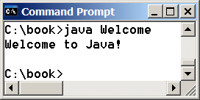
Trace a Program Execution
animation
// This program prints Welcome to Java!
public class Welcome {
public static void main(String[] args) {
System.out.println("Welcome to Java!");
}
}
print a message to the console

Slide 42
Two More Simple Examples
WelcomeWithThreeMessages
ComputeExpression

Slide 43

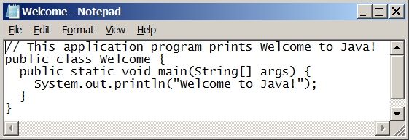
Creating and Editing Using NotePad
To use NotePad, type
  notepad Welcome.java
from the DOS prompt.

Slide 44

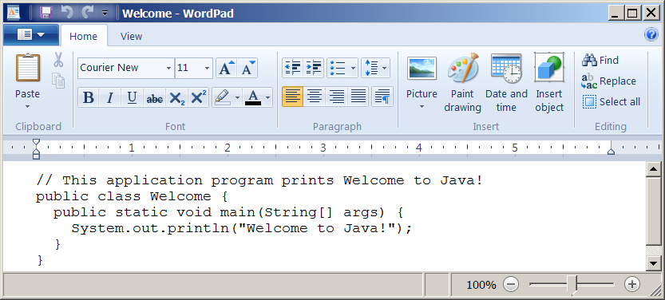
Creating and Editing Using WordPad
To use WordPad, type
  write Welcome.java
from the DOS prompt.

Slide 45
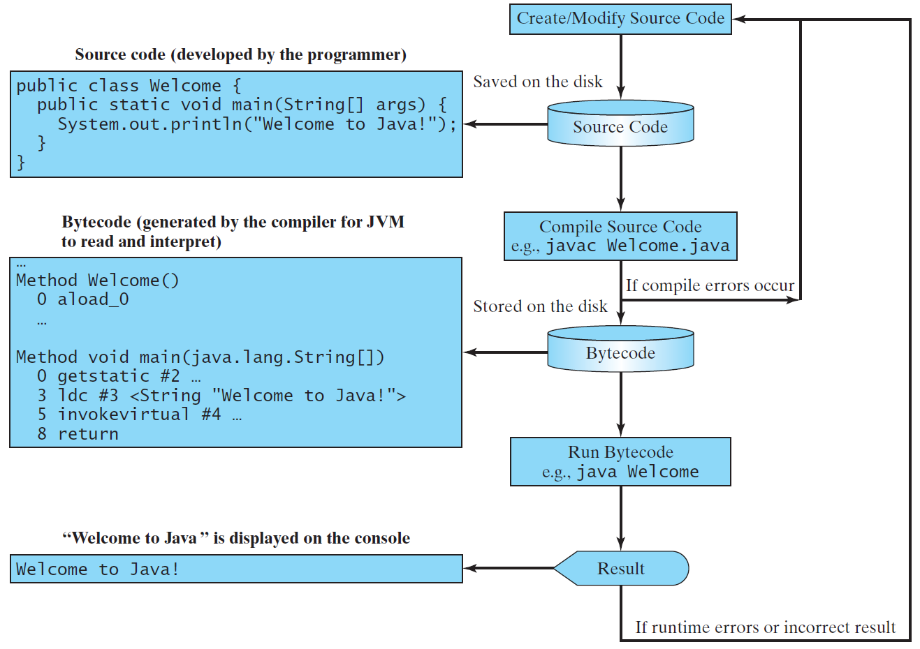
Creating, Compiling, and Running Programs

Slide 46
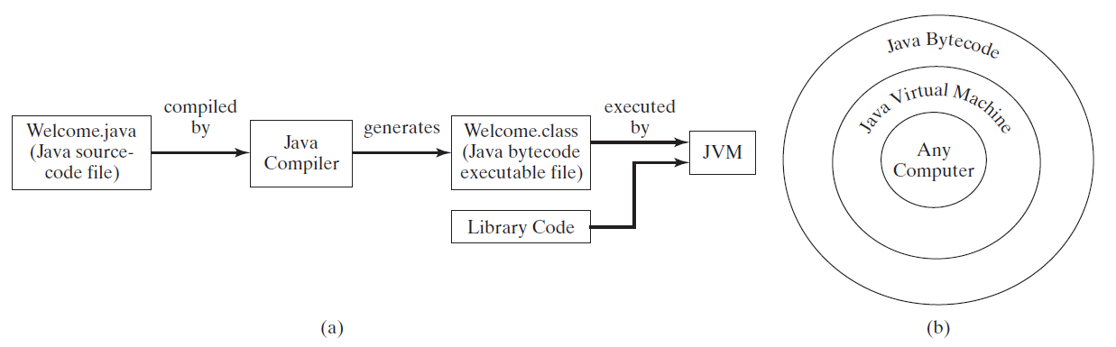
Compiling Java Source Code
You can port a source program to any machine with appropriate compilers. The source program must be recompiled, however, because the object program can only run on a specific machine. Nowadays computers are networked to work together. Java was designed to run object programs on any platform. With Java, you write the program once, and compile the source program into a special type of object code, known as bytecode. The bytecode can then run on any computer with a Java Virtual Machine, as shown below. Java Virtual Machine is a software that interprets Java bytecode.

Slide 47
Supplements on the Companion Website
Companion Website
See Supplement I.B for installing and configuring JDK
See Supplement I.C for compiling and running Java from the command window for details
www.pearsonhighered.com/liang

Slide 48
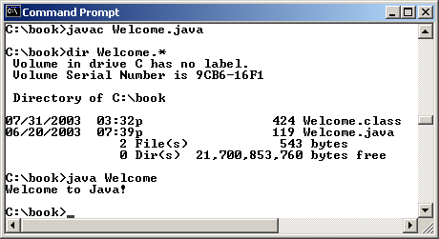
Compiling and Running Java from the Command Window
Companion Website
Set path to JDK bin directory
  set path=c:\Program Files\java\jdk1.8.0\bin
Set classpath to include the current directory
  set classpath=.
Compile
  javac Welcome.java
Run
  java Welcome

Slide 49
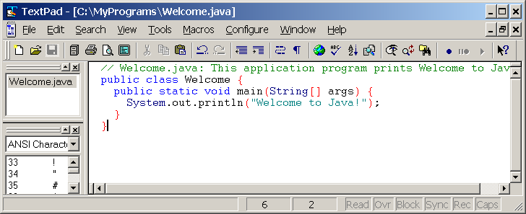
Compiling and Running Java from TextPad
Companion Website
See Supplement II.A on the Website for details

Slide 50
Anatomy of a Java Program
Class name
Main method
Statements
Statement terminator
Reserved words
Comments
Blocks

Slide 51
Class Name
Every Java program must have at least one class. Each class has a name. By convention, class names start with an uppercase letter. In this example, the class name is Welcome.
// This program prints Welcome to Java!
public class Welcome {
public static void main(String[] args) {
System.out.println("Welcome to Java!");
}
}

Slide 52
Main Method
Line 2 defines the main method. In order to run a class, the class must contain a method named main. The program is executed from the main method.
// This program prints Welcome to Java!
public class Welcome {
public static void main(String[] args) {
System.out.println("Welcome to Java!");
}
}

Slide 53
Statement
A statement represents an action or a sequence of actions. The statement System.out.println("Welcome to Java!") in the program in Listing 1.1 is a statement to display the greeting "Welcome to Java!“.
// This program prints Welcome to Java!
public class Welcome {
public static void main(String[] args) {
System.out.println("Welcome to Java!");
}
}

Slide 54
Statement Terminator
Every statement in Java ends with a semicolon (;).
// This program prints Welcome to Java!
public class Welcome {
public static void main(String[] args) {
System.out.println("Welcome to Java!");
}
}

Slide 55
Keywords
Keywords are words that have a specific meaning to the compiler and cannot be used for other purposes in the program. For example, when the compiler sees the word class, it understands that the word after class is the name for the class.
// This program prints Welcome to Java!
public class Welcome {
public static void main(String[] args) {
System.out.println("Welcome to Java!");
}
}

Slide 56
Blocks
A pair of braces in a program forms a block that groups components of a program.

Slide 57
Special Symbols

Slide 58
{ … }
// This program prints Welcome to Java!
public class Welcome {
public static void main(String[] args) {
System.out.println("Welcome to Java!");
}
}

Slide 59
( … )
// This program prints Welcome to Java!
public class Welcome {
public static void main(String[] args) {
System.out.println("Welcome to Java!");
}
}

Slide 60
;
// This program prints Welcome to Java!
public class Welcome {
public static void main(String[] args) {
System.out.println("Welcome to Java!");
}
}

Slide 61
// …
// This program prints Welcome to Java!
public class Welcome {
public static void main(String[] args) {
System.out.println("Welcome to Java!");
}
}

Slide 62
" … "
// This program prints Welcome to Java!
public class Welcome {
public static void main(String[] args) {
System.out.println("Welcome to Java!");
}
}

Slide 63
Programming Style and Documentation
Appropriate Comments
Naming Conventions
Proper Indentation and Spacing Lines
Block Styles

Slide 64
Appropriate Comments
Include a summary at the beginning of the program to explain what the program does, its key features, its supporting data structures, and any unique techniques it uses.
Include your name, class section, instructor, date, and a brief description at the beginning of the program.

Slide 65
Naming Conventions
Choose meaningful and descriptive names.
Class names:
  Capitalize the first letter of each word in the name. For example, the class name ComputeExpression.

Slide 66
Proper Indentation and Spacing
Indentation
  Indent two spaces.
Spacing
  Use blank line to separate segments of the code.

Slide 67
Block Styles
Use end-of-line style for braces.

Slide 68
Programming Errors
Syntax Errors
  Detected by the compiler
Runtime Errors
  Causes the program to abort
Logic Errors
  Produces incorrect result

Slide 69
Syntax Errors
public class ShowSyntaxErrors {
public static main(String[] args) {
System.out.println("Welcome to Java);
}
}
ShowSyntaxErrors

Slide 70
Runtime Errors
public class ShowRuntimeErrors {
public static void main(String[] args) {
System.out.println(1 / 0);
}
}
ShowRuntimeErrors

Slide 71
Logic Errors
public class ShowLogicErrors {
public static void main(String[] args) {
System.out.println("Celsius 35 is Fahrenheit degree ");
System.out.println((9 / 5) * 35 + 32);
}
}
ShowLogicErrors

Slide 72
Compiling and Running Java from NetBeans
Companion Website
See Supplement I.D on the Website for details

Slide 73
Compiling and Running Java from Eclipse
Companion Website
See Supplement II.D on the Website for details

